Slide 1
Android SDK
Virtual Reality Course Slide 2012.3.13

Slide 2
References
NTU Mobile HCI Lab, Mike Chen
  http://www.ntumobile.org/
Android Developers
  http://developer.android.com/sdk/installing.html
孫傳雄談科技
  http://blog.chinatimes.com/tomsun/archive/2010/09/07/536320.html

Slide 3
Tools Needed
JDK (Java SE Development Kit)
  http://www.oracle.com/technetwork/java/javase/downloads/index.html
Android SDK (android software development kit)
  http://developer.android.com/sdk/index.html
Eclipse (Eclipse IDE for Java Developers)
  http://www.eclipse.org/downloads/
ADT Plugin for Eclipse
  http://developer.android.com/sdk/eclipse-adt.html

Slide 4
Install Procedure
JDK
Eclipse
ADT
Android SDK

Slide 5
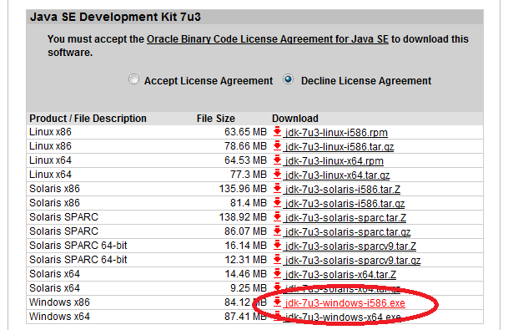
JDK
http://www.oracle.com/technetwork/java/javase/downloads/jdk-7u3-download-1501626.html

Slide 6
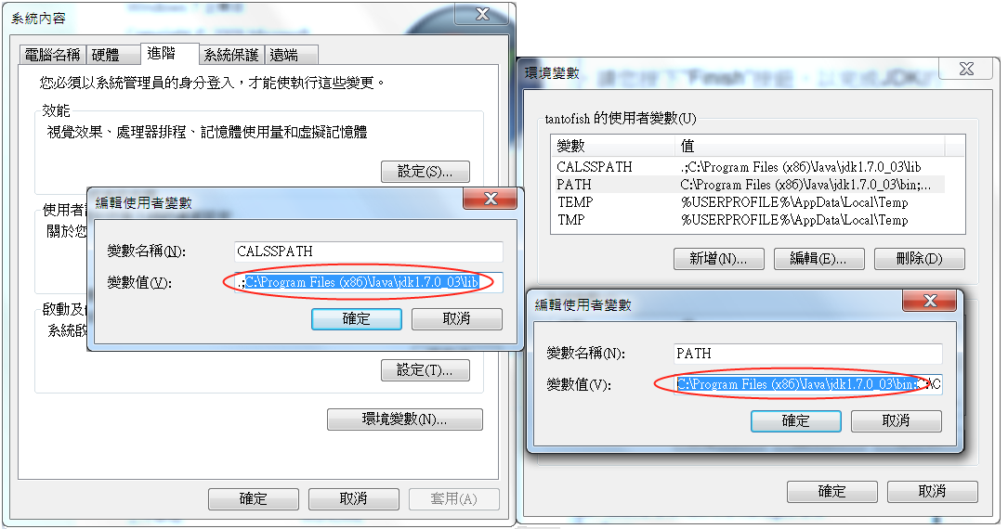
JDK
環境變數(Environment Variables)

Slide 7
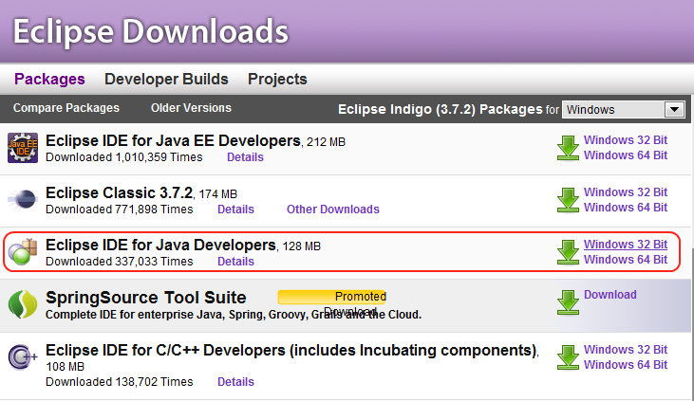
Eclipse
http://www.eclipse.org/downloads/

Slide 8
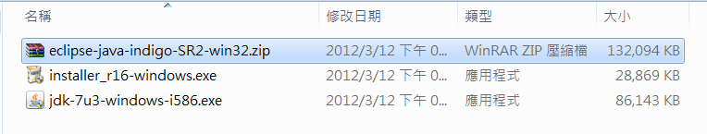
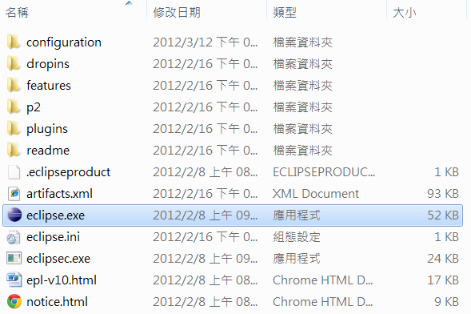

Eclipse

Slide 9
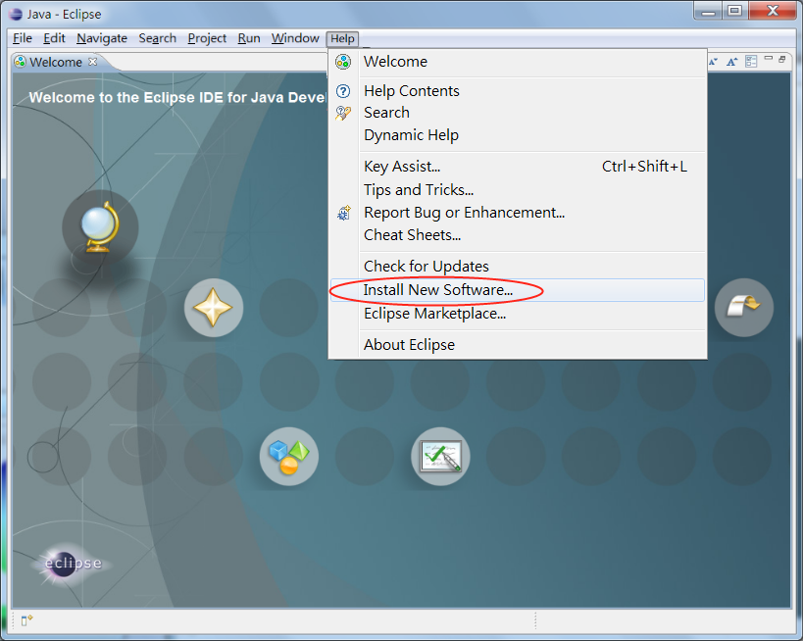
ADT
Help -> Install New Software

Slide 10
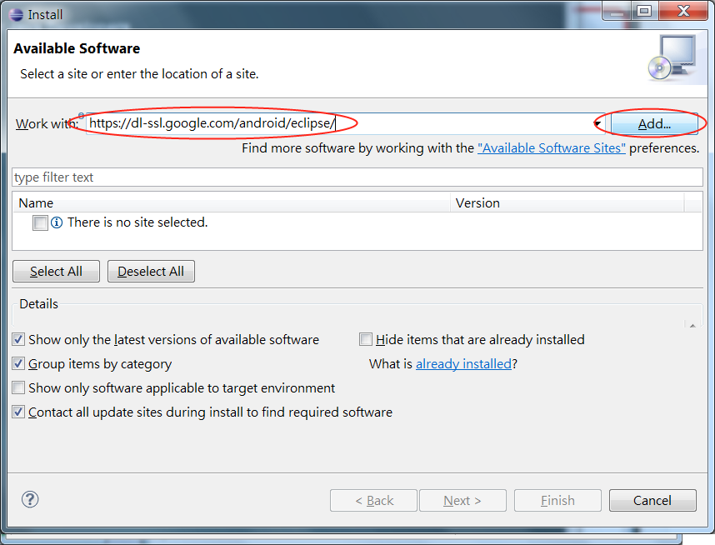
ADT
https://dl-ssl.google.com/android/eclipse/
Add…
Name:ADT
OK

Slide 11
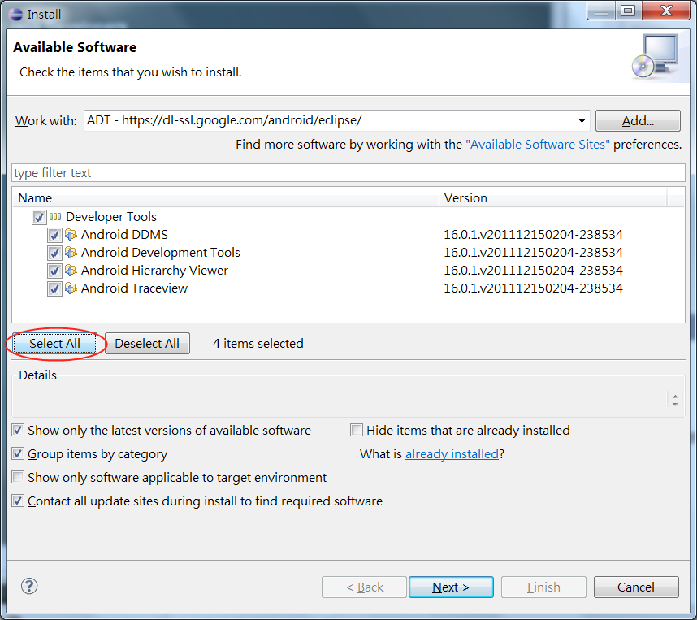
ADT
Select All
Next

Slide 12
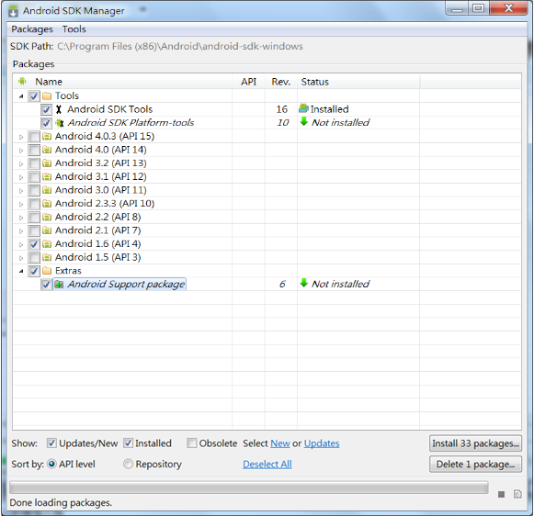
Android SDK
  http://developer.android.com/sdk/index.html
  android-sdk_r16-windows.zip
  Run SDK Manager
  Select Android 1.6
  (or higher if needed)
  Install Packages

Slide 13
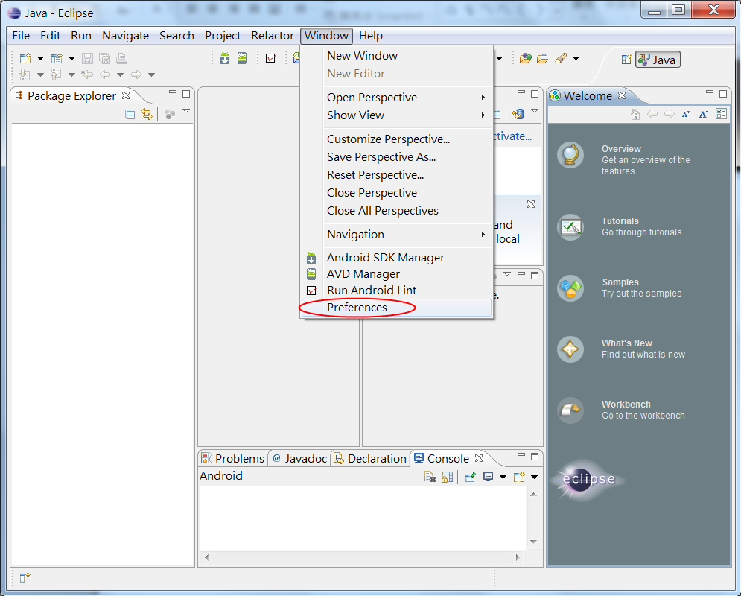
Android SDK
  Eclipse
  Window
  Preferences

Slide 14
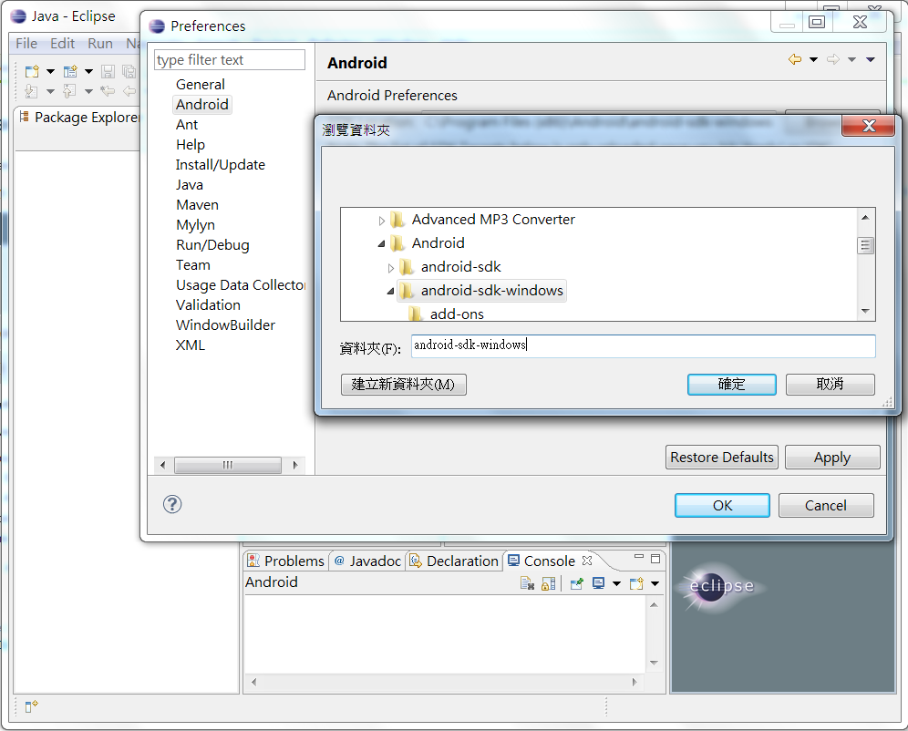
Android SDK
  Eclipse
  Window
  Preferences
  Android
  Browse…
  android-sdk-windows

Slide 15
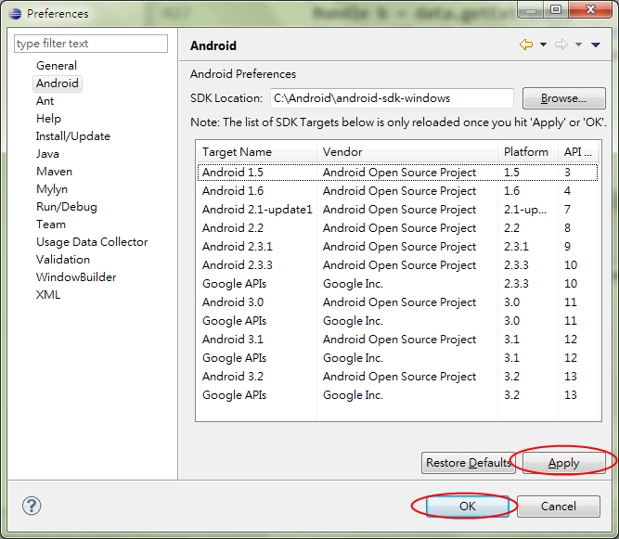
Android SDK
  Eclipse
  Window
  Preferences
  Android
  Browse…
  android-sdk-windows
  Apply
  OK

Slide 16
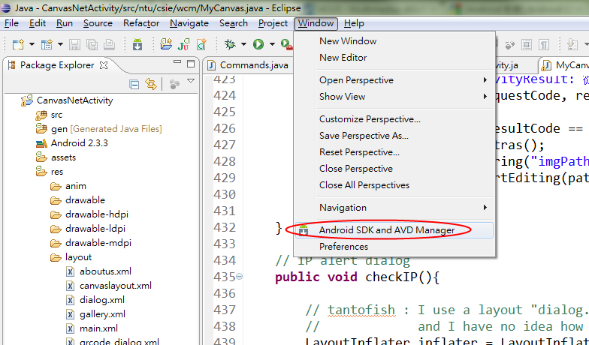
AVD(Android Virtual Device)
  Eclipse -> Window -> Android SDK and AVD Manager

Slide 17
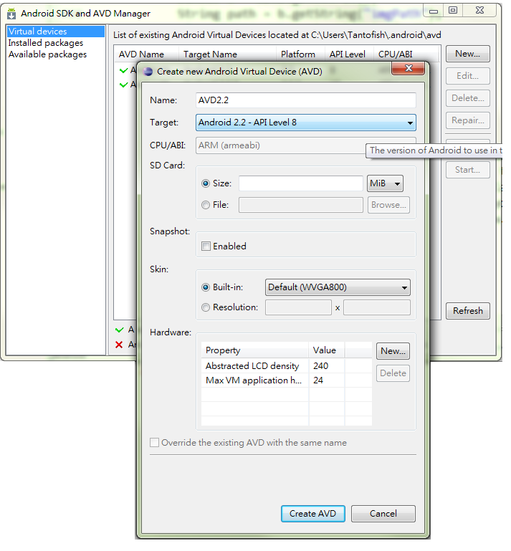
AVD(Android Virtual Device)
  New
  Choose platform
  Create AVD

Slide 18
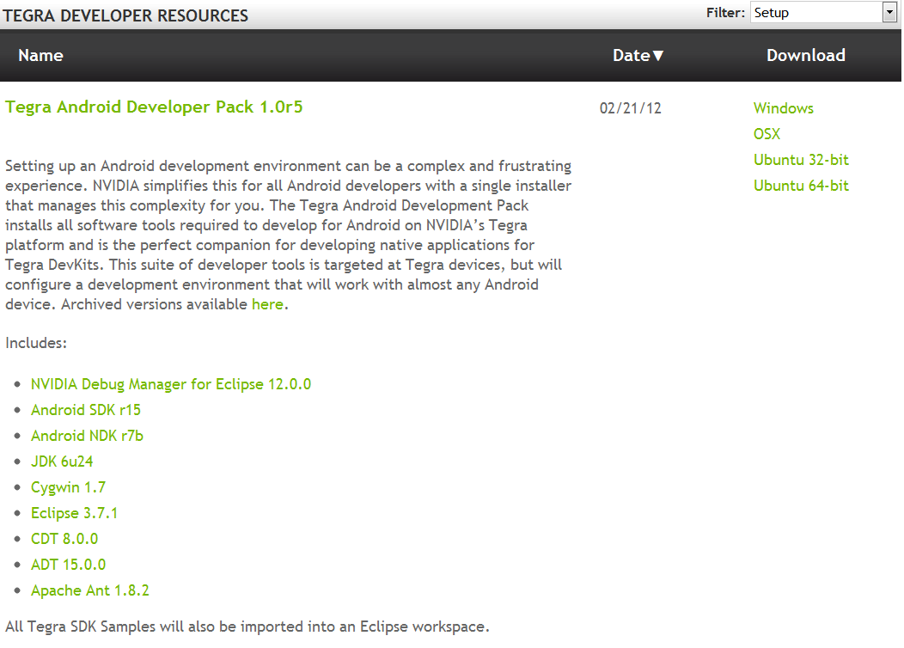
NVIDIA Pack
http://developer.nvidia.com/tegra-resources

Slide 19
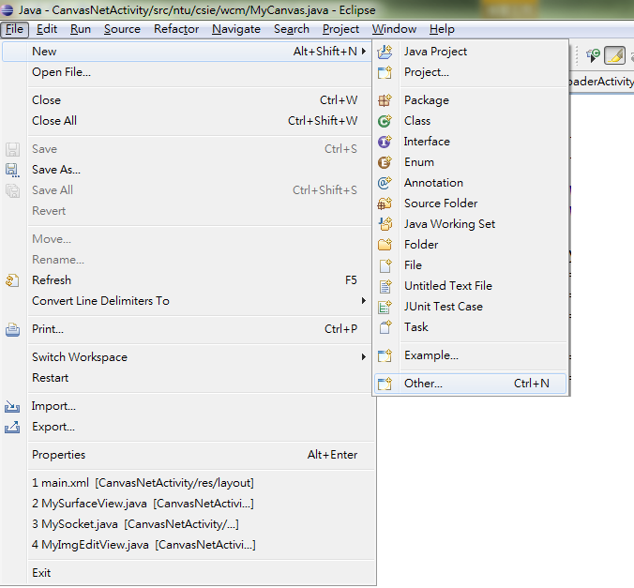
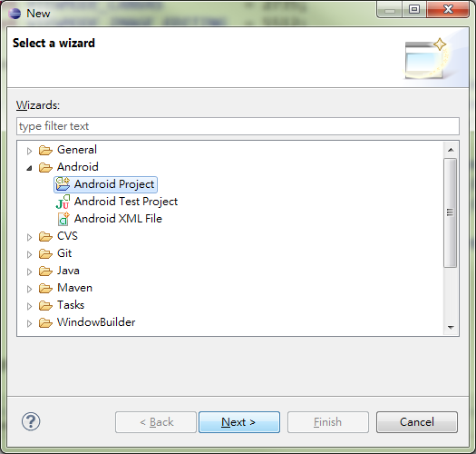
HelloWorld!!!
File
->New
->Other
->Android
->Android
Project
->Next

Slide 20
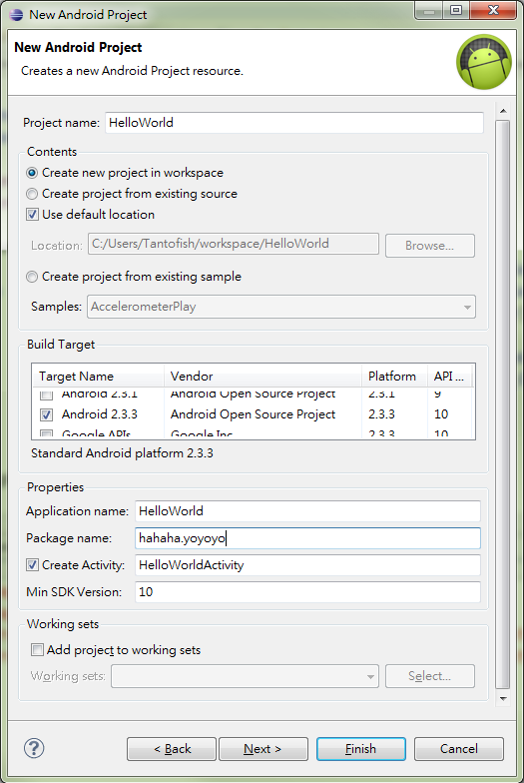
HelloWorld!!!
Project name
Create new project in workspace
Select android platform
Application name
Package name
Finish

Slide 21
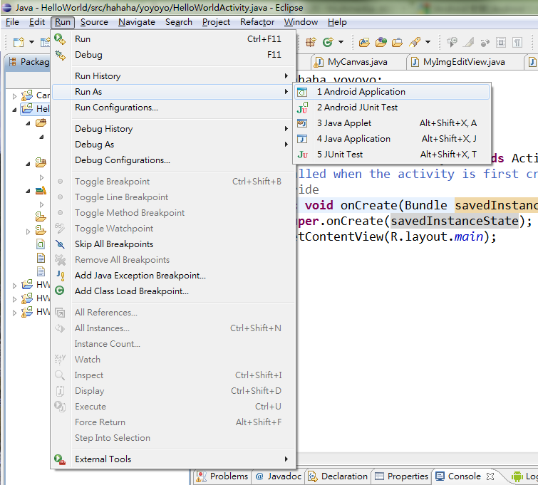
HelloWorld!!!
Run -> Run As -> Android Application

Slide 22
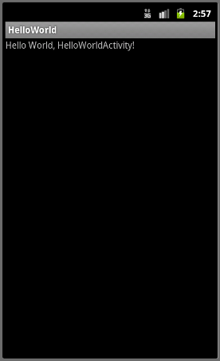
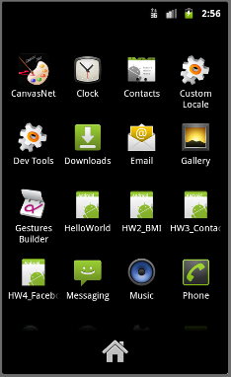
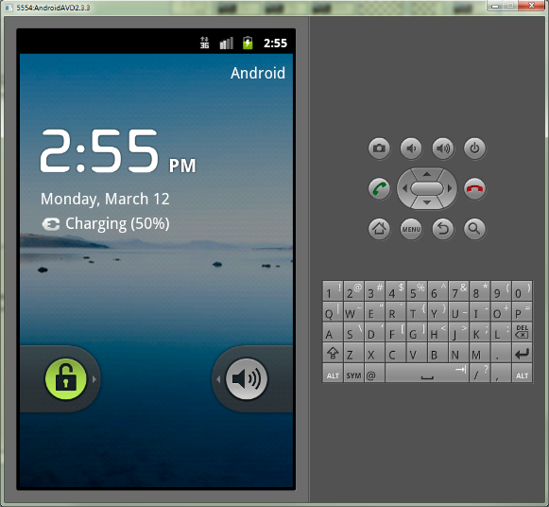
HelloWorld!!!

Slide 23
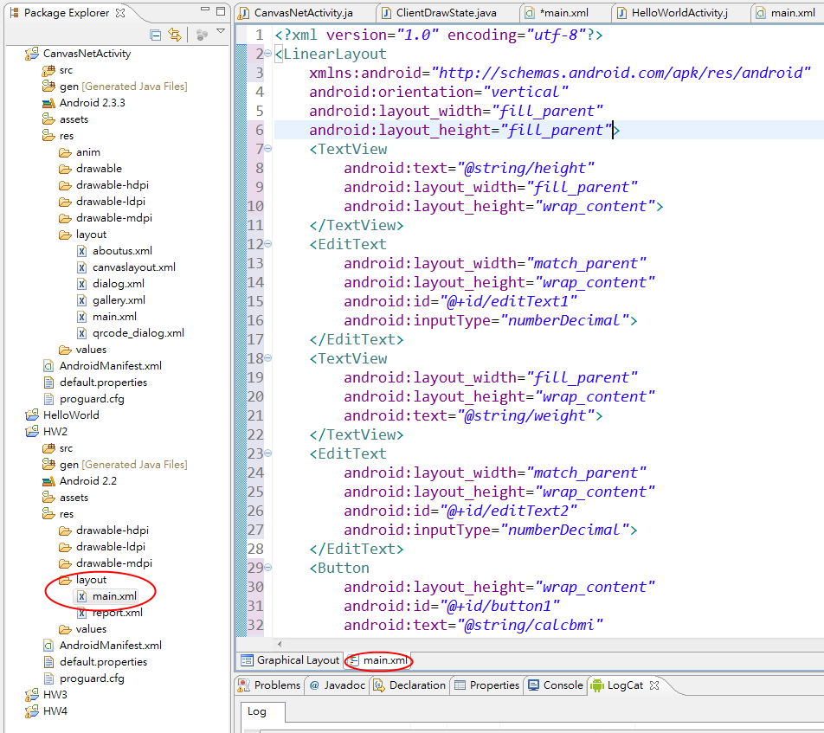
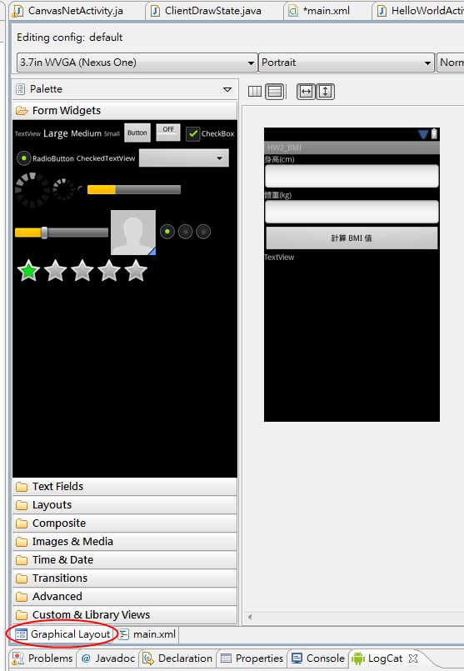
Layout

Slide 24
OpenGL ES
Android APIs
  http://developer.android.com/guide/topics/graphics/opengl.html
  http://cheng-min-i-taiwan.blogspot.com/2011/04/android-opengl-es.html
NDK
  http://developer.android.com/sdk/ndk/index.html
  Sample code: ~\android-ndk-r7b\samples\hello-gl2

Slide 25
Things you may need to know
Log
Activity
Intent
Bundle
Preference
Life Cycle
Thread
ListView
Dialog
Menu
…

Slide 26
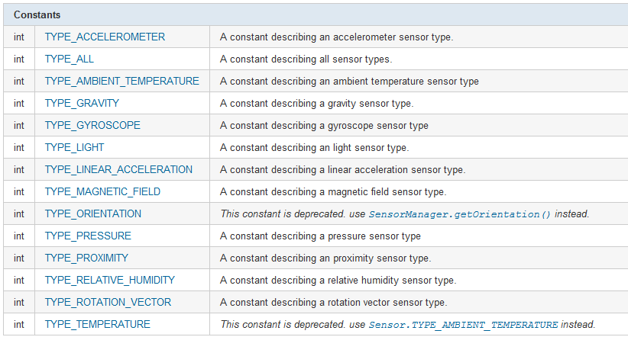
Sensor
http://developer.android.com/reference/android/hardware/Sensor.html
http://developer.android.com/reference/android/hardware/SensorManager.html
http://developer.android.com/reference/android/hardware/SensorEvent.html

Slide 27
iOS
IDE: xCode
Language: Objective-C
Stanford CS193P iPhone Application Development
  http://www.stanford.edu/class/cs193p/cgi-bin/drupal/downloads-2010-fall

