Slide 1
Google glasses
Ming Ouhyoung

Slide 2
Specification
The core of Google Glass is its tiny prism display which sits not in your eyeline, but a little above it. You can see what is on the display by glancing up. The glasses also have an embedded camera, microphone, GPS and, reportedly, use bone induction to give you sound.

Slide 3
the glasses are expected "to cost around the price of current smartphones." So that's around $750/£500, then, possibly with the help of a hefty Google subsidy.

Slide 4
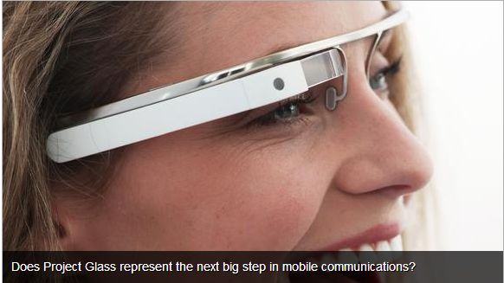
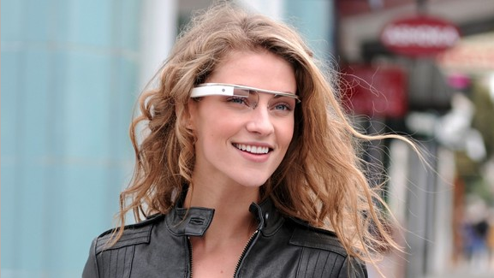
Google Glass 2013

Slide 5
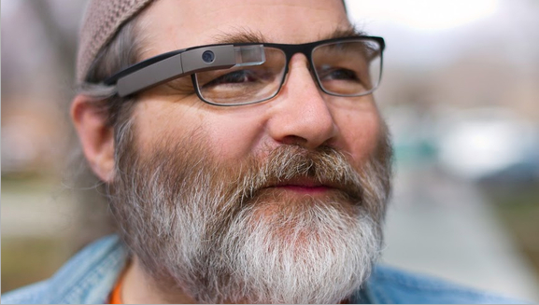
Google Glass

Slide 6
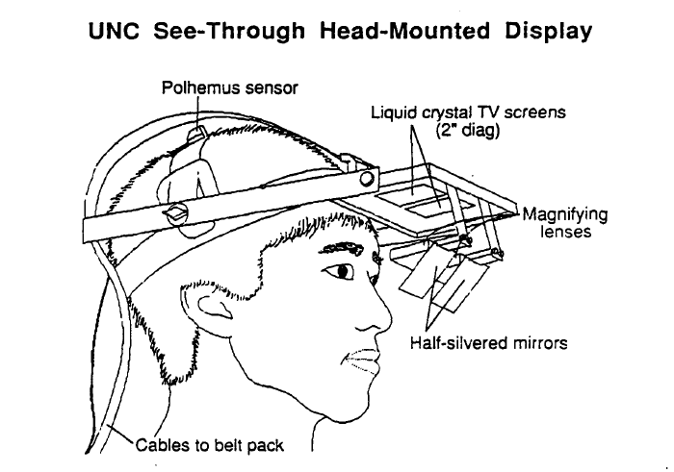
UNC See-through
Head-mounted display (1989)

Slide 7
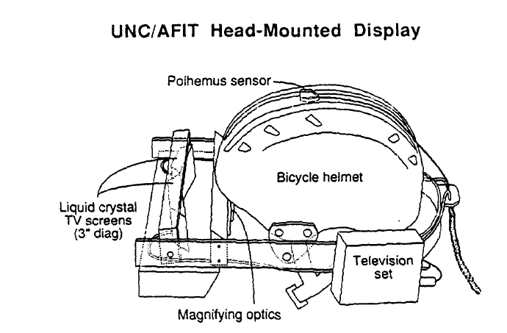
UNC-US AF
Head-mounted display (1989)

Slide 8
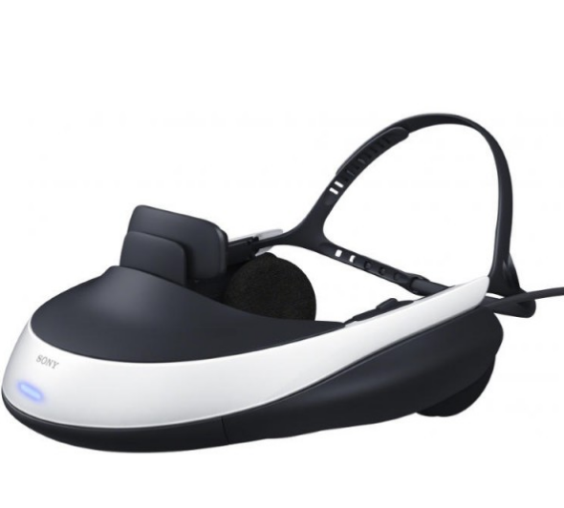
Sony HMD

Slide 9
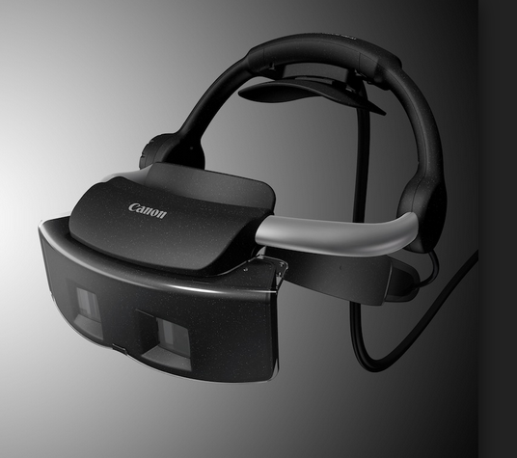
Canon Mixed Reality HMD

Slide 10
Head up display: used in pilots of fighter planes.
No need of stereo display.
In car business: embed front panel display.

Slide 11
Why important
Popularity of smart phones
Constant information display by Internet explorers, Chrome, Safari, etc.
Not allowed to use smart phones during driving for the driver.
However, important short messages are necessary, including Yes/No quick answers.
Stereoscopic display is not a must, but nice to have.

Slide 12
New VR/AR glasses design
See through features
Light weight,
Independent of eye sight values (near sight, far sight for elders), so that original eyeglasses can be used.
Appears to be at least 40 cm ahead.
Simple gesture recognition, Yes/No selection, slider up/down, left/right.

