Slide 1
Ray Tracing by GPU
Ming Ouhyoung

Slide 2
Outline
Introduction
Graphics Hardware
Streaming Ray Tracing
Discussion

Slide 3
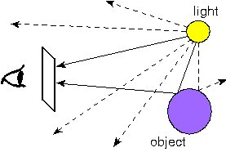
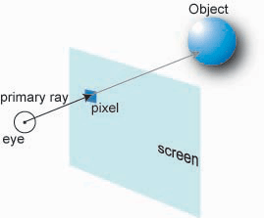
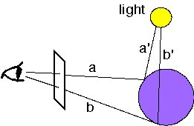
Introduction to Ray Tracing

Slide 4
Why Use Programmable Graphics Cards
GPU vs. Chips specialized for ray tracing
For the goal of providing maximum performance at the lowest cost, GPU can perform CPU-based algorithms without requiring fundamentally new hardware.

Slide 5
Approach I
The Ray Engine [Graphics Hardware, 2002]
use textures to hold the model and ray data
use pixel shader to compute the intersection test
the result are read back on to the AGP bus (bottleneck)

Slide 6
Approach II
Ray Tracing on Programmable Graphics Hardware [ACM Transactions on Graphics, 2002]
view a GPU as a general-purpose parallel/streaming processor
map ray tracing onto a streaming model of computation

Slide 7
Graphics Hardware

Slide 8
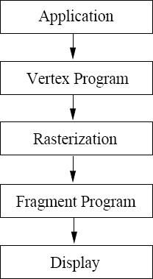
Graphics Pipeline

Slide 9
Ray Tracing Kernels
Eye Ray Generator
produces a stream of viewing rays (pixels)
Traverser
steps rays through the grid until the ray encounters a voxel containing triangles.
Intersector
Shader

Slide 10
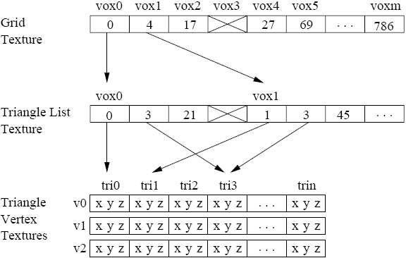
Traverser

Slide 11
Intersector
Test ray intersections with all the triangles contained in the voxel.
2 types of output:
If hit then output the ray and the triangle for shading.
else pass the ray back to the Traverser and the search continues.

Slide 12
Shader
If a ray terminates at this hit, then the color is written to the accumulated image.
may generate shadow or secondary rays and pass them back to the traversal stage.

Slide 13
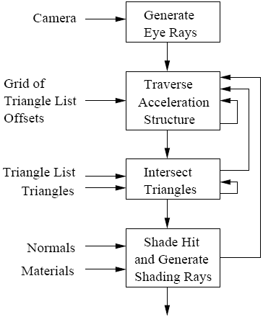
Streaming Ray Tracing

Slide 14
Pixel Shader Architecture
Multipass Architecture
Branching is implemented by loop
Branching Architecture
requires only a single pass.
requires significantly less bandwidth, and is compute-limited.

Slide 15
Discussion
Acceleration data structures
Static vs. Dynamic scenes
Multipass vs. Branching
CPU vs. GPU

