Slide 1
Virtual Reality Oral Present
- Chapter 8 Part II
Ming Ouhyoung

Slide 2
Creating a VR Application
  Adapting from other Media
  Adapting from an Existing VR Experience
  Creating a New VR Experience

Slide 3
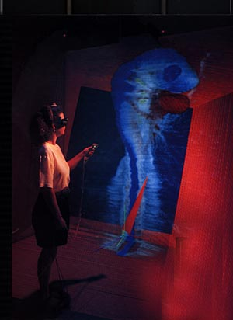
Adapting from an Existing VR Experience
Converting an existing VR application into one suitable for your needs
Crumbs visualization application
  Crumbs is a visualizing, exploring, and measuring features within volumetric data sets. (Appendix B)
Website : http://www.ncsa.uiuc.edu/VR/cavernus/CRUMBS/Crumbs.html
Notes:
1.
2.National Center for supercomputing Applications http://www.ncsa.uiuc.edu/VR/cavernus/CRUMBS/Crumbs.html

Slide 4
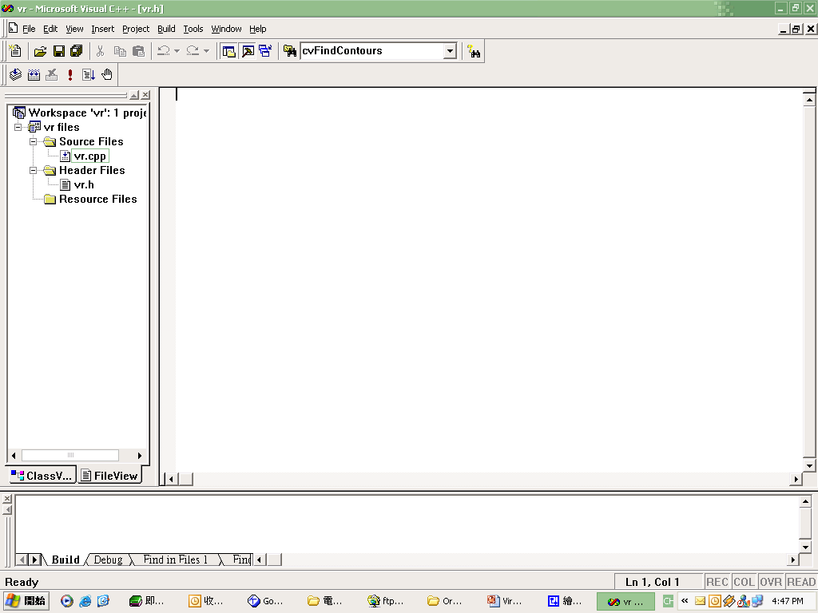
Creating a New VR Experience
Creating an experience from scratch allows the most flexibility but will require the most effort.
Notes:
1.一個創作從無開始的話，是最有彈性的，但是往往要花上很大的精力才能完成一定的成果，因此…
2.接下來所教的就是，如何最有效率的創造出一個成功的VR experience

Slide 5
The Experience Creation Process
There are courses of action by which one can reduce the amount of wasted effort.
Many successful VR experiences and other computer applications have relied on user tests to hone the content and the interface.
Notes:
1.有很多課程就是在教你，在做一個VR的project時，怎麼樣才能最有效減少浪費的時間…譬如本課程…這些課程往往會讓學習者接觸到VR的一些器材及觀念
2.一個成功的VR 往往依靠的是不停的測試，界面以及內容是否合乎使用者的方便及需求

Slide 6
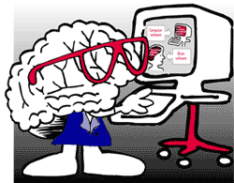
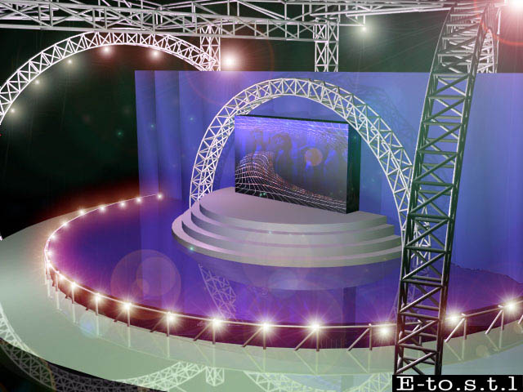
The Experience Creation Process
Form your VR team - What people do you need?
  Programmers
  Content Experts
  Set Designers
  Prop Creators
  (theatrical property, the stage)
  Sound Effect Experts
  Hardware Engineers
Notes:
當我們把握住大觀念後…
1.首先，因為VR是Computer-based medium
2.了解使用者
6.hardware/software video/audio

Slide 7
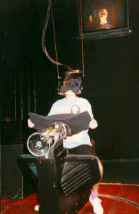
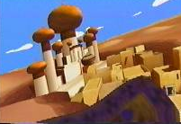
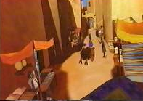
The Experience Creation Process
It’s generally wise to use a software system!!
  More flexible
Disney Aladdin VR experience
  SAL : a Development language of Disney team
Notes:
Story Animation Language

Slide 8
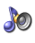
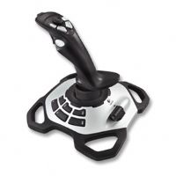
The Experience Creation Process
A Typical VR system
Notes:
Figure 8-4 The hardware components will need to be gathered and integrated
1.user-monitoring hardware
2.Primary computer (rendering engine , “physics simulation”
3.Display – visual, aural, haptic

Slide 9
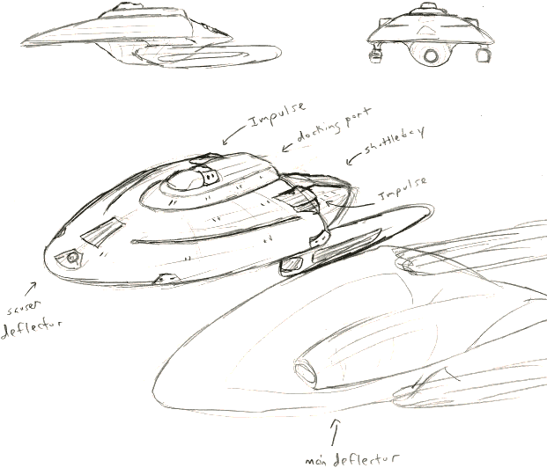
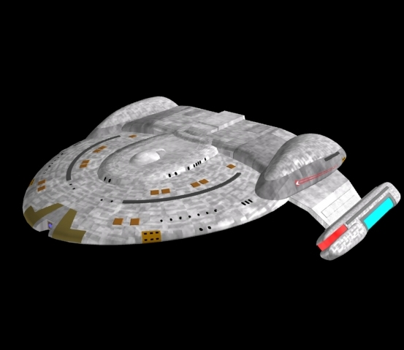
Designing a VR Experience
It’s wise to approach the creation of a VR experience with good design practices.
Notes:
畫家要畫草稿，製片家要不停的製作storyboard，建築師蓋房子前要畫藍圖…

Slide 10
Design Deliberately
Customer Highest !!
  Design to make things easier for the user, not the programmer.
Looking from the top down
  Design a VR experience should be constructed looking from the global view toward the goal.
Don’t Just keep a particular feature. If the feature doesn’t live up for the user’s experience, then it isn’t worth keeping.
Don’t forget the special features in VR
  Virtual Reality has more options than day to day reality.
Notes:
1.相對於做生意，對VR來說 我們的顧客就是使用者…
2.抓住你想呈現的訊息 和情景 以及使用者的感受…
3.不要說想到了一個很好的idea就死命的抓著不放，應該要評估那個idea對使用者是否是一個適合選擇…
4.跳脫現實的侷限

Slide 11
Design with the System in Mind
Use an existing system, or make from scratch ?
If your project will continued for a considerable amount of time,
  You can take advantage of the fact that technology is getting improved.
If your project will involve large hardware
  You may convince your hardware manufacturer to let you test out the next generation of their product.
Notes:
這裡剛好跟前一段的Adapting an existing VR experience 呼應

Slide 12
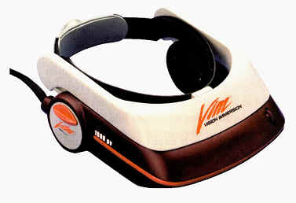
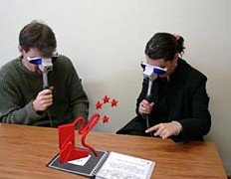

Design with the Venue in Mind
If a venue with limited space
  Likely require a HBD (head –based)
  or HMD (head-mounted display)
If the venue is theater-style
  High-resolution projection-based display
If venue is so large that participant can roam
  Non-occlusive HBD or hand-based display
Notes:
1.假設展示場空間有限
2.戲院型的寬廣空間
3.…

Slide 13
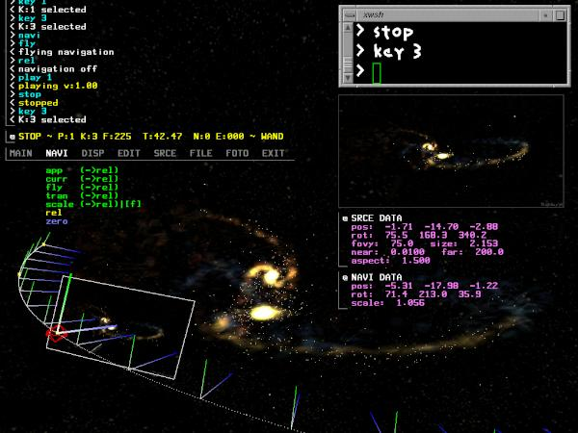
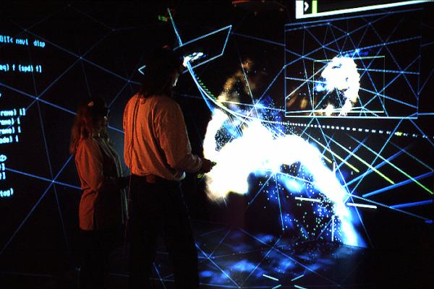
Design with the Audience in Mind
Know your audience is the most important tenet a designer should remember.
NCSA’s Virtual Director application is a VR tool using widely for computer animation
If General Audience
  Avoid language-based messages
  Choose internationally recognizable sounds and symbols
Notes:
1.Audience 聽眾 其實指的就是妳的使用者…
2.NCSA : National Center for Supercomputing Applications
3.對一般情況而言…

Slide 14
Design with the Audience in Mind
AGE : If user is child
  Head-based displays and shutter glasses may slip off
EXPERIENCE :
  Children - Easy
  Adults – Car-like steering interface
  Videogame players – Complicated handler
CULTURE :
  Virtual VR arcade system was being deployed in the Middle East, they discovered that most men wore a headdress, they could not don the standard HMD

