Slide 1
Experience Design: Applying VR to a Problem (III)
Ming Ouyoung
Notes:
Experience: 體驗

Slide 2
Outline
Consider Design Tradeoffs
Design the User Objective
Design the End of the Experience
Document, Deploy, and Evaluate the Experience
The Future of VR Design
Notes:
Tradeoff(交換條件)

Slide 3
Consider Design Tradeoffs
Between world complexity and expense required for high computer performance.
World complexity affects how the designers choose to represent the world.
Ex. A representation using highly complex rendering techniques may be totally inappropriate for a system with less graphical rendering power.
Notes:
世界複雜度 與 計算效能上的tradeoff
世界的複雜度將會影響設計者的選擇，選擇用什麼方式來呈現這個世界

Slide 4
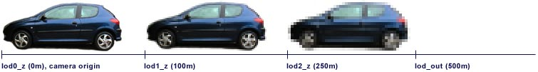
Consider Design Tradeoffs
Between the complexity of interaction in the world and the narrative.
Limiting the path of travel
Only concern with the world near the user’s path.
LOD (Level of Details)
PMesh (Progressive meshes)
Notes:
互動的複雜性與敘事性
2,3. 藉著限制路徑，設計不須創造整個世界的所有細節，只要考慮使用者路徑附近的世界。

Slide 5
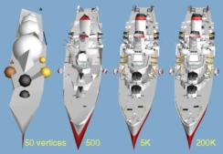
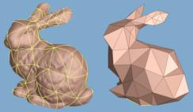
Consider Design Tradeoffs
Hugues Hoppe
http://research.microsoft.com/~hoppe/
Notes:
pmesh

Slide 6
Consider Design Tradeoffs
Allow the user full freedom to move but keep them within certain regions, through constraints other than limiting path.
Flight simulation: designers can keep you in a certain space by ensuring that if you go outside of that space you will be shot down.
Aladdin’s Magic Carpet Ride: by creating regions of the world where the user doesn’t go because they’re uninteresting or impassable.
Notes:
1.允許使用者可完全自由在特定範圍內移動，透過constraints而非限制路徑
2.設計者只須擔心你最有可能去的地方，儘管你有完全自由，但事實上你被constrained了。
3.例如:有一個峽谷太高了，對使用者而言根本過不去，即使使用者的感覺是完全自由的，但卻有隱藏的限制存在。

Slide 7
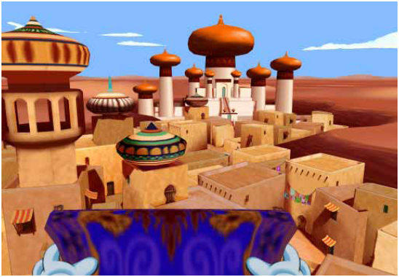
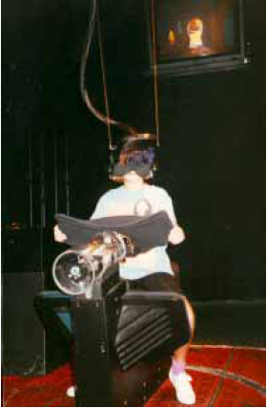
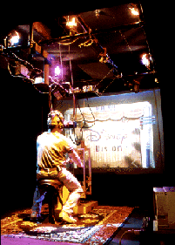
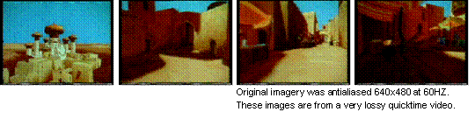
Consider Design Tradeoffs
Aladdin’s Magic Carpet Ride
http://www.realityprime.com/disney.htm
http://vr-atlantis.com/lbe_guide/lbe_pictures.html

Slide 8
Consider Design Tradeoffs
Controlling the narrative, directing the user’s experience
Constraining travel
Apply more creation and rendering resources, that are particularly interesting to participants, in detail.
Notes:
Constraining travel 表面上創造了一個複雜的世界，藉著將使用者導向重要的區域，以維持玩家的興趣。
玩家越感興趣的東西做得越詳細。

Slide 9
Consider Design Tradeoffs
The most effective presentation is not always the most complex.
Kathryn Best: “The answer is not to simplify everything, but to emphasize certain features and let the brain fill in the rest.”
Notes:
Merely adding lots of polygons to an objects to make it look more realistic is not always the answer.
Book: the idiots’ guide to virtual world design.

Slide 10
Design the User Objective
The user should feel that the application has a purpose.
Applications may be designed to entertain, educate, enlighten, visualize information, and so on, but there must be either a narrative or task that can be carried out.
Not just entertainment in VR. Left undirected, people got bored and asked what they should do.
Notes:
2.例如: 在阿拉丁魔毯，迪士尼設計團隊做了一個實驗，人們只能忍受漫無方向、無目的的遊走最多兩分鐘，之後他們會想要一些方向(指導)。
3.Left undirected 放任使用者而不指導他，他會覺得無聊，而且會問他到底該作什麼?

Slide 11
Design the User Objective
Type and amount of user interface depends on the objective.
For applications in which the user must be able to manipulate objects, the interface becomes more complicated.
The more complicated the interactions and the interface, the more user testing must be done – another tradeoff.
Notes:
1. If the experience is primarily a ride along or even a fly-through with little interaction with object in the world, then a fairly simple user interface can be developed.
3. 互動或介面越複雜，就必須做更多的測試。

Slide 12
Design the End of the Experience
Open ended: user in the virtual world for an indefinite amount of time.
Concrete ended: definite close.
Neither open ended nor fixed experiences require a participant to be immersed uninterrupted for the entire duration.
Many VR applications allow the participant to return later and pick up where they left off.
Notes:
持續/長期體驗
3. 不管是open ended或fixed experiences, 在整個期間都不會要求參與者一定要完全沉浸而不受打擾中斷
4. 許多應用都允許參與者可以待會再回來, 然後回到他上次停止的地方。

Slide 13
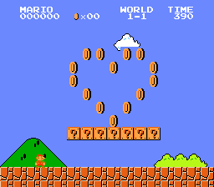
Design the End of the Experience
Three ways a quintessential(classical) non-perpetual experience may end:
Time expiration (ex. 5 minutes are up)
Terminal event (final ball drops)
Early user termination (user leaves from boredom)
Notes:
非長期性體驗
這種體驗例如彈珠抬和videogame,每次都從頭開始(0分,level one), 最後一個錯誤發生，例如死掉,球掉了，體驗就結束了。瑪莉兄弟也屬於這種非長期性的體驗。去電影院看電影，從頭開始播，在所有資訊都呈現出來之後，便結束了，假如你想重新體驗，就必須從頭開始。

Slide 14
Design the End of the Experience
The first two publicly exhibited Alladdin experiences lasted 5 minutes:
tried to accomplish a specific goal to win the game.
extra time was not given to allow the participant a chance to just explore the world.
Ford Galaxy VR experience
Fixed-length narrative with a complete story (begin, middle, and end).
Notes:
Ford: 使用者被提示進入車內，當他們被載往終點的過程中，車子的特性就已經完全解釋了，當他們到達終點，整個旅程體驗就結束，離開這個系統。

Slide 15
Design the End of the Experience
Less narratively oriented applications can also be made to work within the confines of a limited-time experience.
Char Davies’s Osmose (15 min. exploration)
Pompeii by STUDIO at CMU (10 min., ending with the eruption of Mt. Vesuvius)
In general, experiences for which throughput is important will be of fixed length.
Notes:
限制時間的缺點
1. 幾乎沒有故事敘述導向的應用可以在限制的時間內完成
1-2. 10分鐘不足以探索整個龐貝城的，所以參與人必須選擇城市的一部分來參觀。
2.

Slide 16
Design the End of the Experience
Open ended experiences
Formal ending: strong narrative, lengthy, eventually do come to a conclusion.
Novel, text adventure (interactive fiction), role-playing games.
Legend Quest game
Open ended
Saving and restoring the state of experience.
Notes:
1-1. 玩家被指定一項任務必須完成，他可能要花20小時或更多時間，但最終最後的謎破解後，最後一頁(破關畫面)就出現了，體驗結束。
1-2-1. open ended, 允許參與人儲存他們的生命值在一張卡上，在每次體驗開始可以加入生命值。
1-2-2. 不管是formal或非formal ending, 這種長期的體驗必須允許儲存與回復體驗狀態，例如圖像呈現工具的參數，小說的書籤，或探險的位置的記錄。當參與人回來，可以從他們上次停止的地方再開始。

Slide 17
Design the End of the Experience
Denouement (ending)
For story or story-oriented experiences, ends are bound up. It is up to content creator.
For exploratory application, it is up to the participant to figure out.
Notes:
對於故事，通常結局是固定的，是由content creator決定的
在一般探索的應用中，結局是靠自己想像的。

Slide 18
Document, Deploy, and Evaluate the Experience
During development, some documentation will likely be available as the VR experience is readied for deployment.
Monitor the user’s proficiency
Provide subtle hints
Nudge users along in the right direction
Notes:
測試平台的發展過程中，會有一連串的常見的問題和錯誤會發生，其實是有很多可參考的文件
2-1. 如果可以監控使用者的熟練度，則可以提供一些微妙/難捉摸的提示，看要如何進行。
2-2. 對於一些故事性的例子而言。
這些hints可以是pop-up message, 或一些agent 會提供一些建議，或只是一個不具體的人聲，這些介面是一種互動的方法來看這個VR應用的說明書(文件)。

Slide 19
Document, Deploy, and Evaluate the Experience
The installation effort and amount of personnel training depend heavily on:
the type of environment
whether it is an existing VR facility.
Any system deployed offsite in a public venue should have easily interchangeable spare units for the most fragile and vulnerable components.
Notes:
這頁是講部署
2. 任何一個系統架在公眾場合公開使用，應該要準備容易替換的多餘零件(耗材)

Slide 20
Document, Deploy, and Evaluate the Experience
What is a good measure of success?
Was the goal attained? -> hard to measure.
More concrete measuring stick, such as profit made or money saved, time saved, or increased test scores.
Whether people did gain new understanding of a concept.
Mentally immersed
Performing better on the job because of the experience.

Slide 21
The Future of VR Design
We are still in the embryonic (萌芽期) stage of the medium.
VR continues to develop and shows promise as a medium capable of impacting the way we communicate, think, do business, and learn.
Notes:
2. 即使有些熱潮已經消退…

Slide 22
The Future of VR Design
Developments
Grow acceptance and familiarity of VR
Have a basic knowledge of what to do in a new VR application.
The technologies that VR is built on will continue to improve.
Facilitating a collaborative VR work environment.
Notes:
1.1 當有更多的VR體驗製作出來，VR的社群就會互相學習，然後成功的interface elements就會變得更普遍。
1.2 建立人們對VR的文化素養，就像我們現在看到的桌上型電腦的介面一樣，滑鼠，鍵盤等等。
1.3 有了這個之後，一些比較差的restrictions，就會被丟在路邊
1.4 現在已有很多新的VR應用能夠與位在另外一個系統上的合作者工作。

Slide 23
The Future of VR Design
Move from specialized, custom-built application toward mass distribution.
Predesigned VR applications for scientific visualization and architectural walkthroughs.
VR tools to help design VR experiences.
Computers may come “VR ready.”
People will be interested in exploring the possible benefits of applying VR to their endeavors.
VR will be used in many new arenas.
Notes:
現在已經有套裝軟體可以減輕設計者的負擔。
這是未來商用軟體將會提供的東西
例如: 有所謂的off-the-shelf(現貨)，就是買得到的商用軟體，可以在現在的家用電腦操作，幫助我們設計建造屬於自己的房子，
也會有更多低成本的硬體可以買得到，造成更多的實驗者，在商業上或在家裡面，開始探索VR的可能性，這也就導致VR軟體現貨的需求。
4~6越講越扯囉，
5. 人們將會對於藉著盡力探索應用VR的可能利益相當有興趣
Arenas(競技場/活動場所/舞台)

