Slide 1
OpenGL & GLUT
TA: I Chiang
Material resource: CMU 15-462 Computer Graphics Courses
Slides: Tsung-Shian Huang and Yu Tu

Slide 2
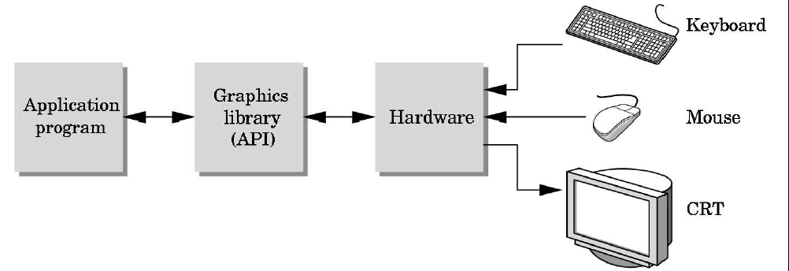
What is OpenGL?
A low-level graphics rendering API. OS independent.
Interact with Graphics Processing Unit (GPU)

Slide 3
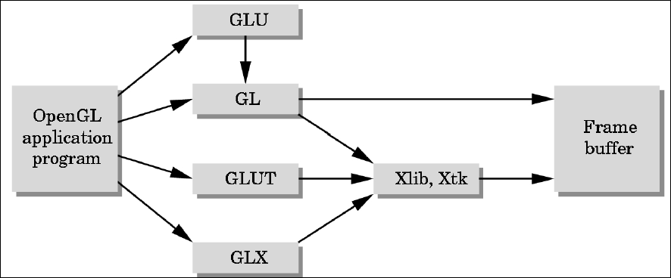
What OpenGL isn’t:
A windowing program or input driver, since those couldn’t be OS independent.
GL: core graphics capability
GLU: utilities on top of GL
GLUT: input and windowing functions

Slide 4
The OpenGL Pipeline
Vertex pipeline
Transformation
&
Lighting
Viewport culling
&
clipping
Primitive
assembly
Rasterization
Pixel pipeline
Texture
blending
Per Fragment
operations
Buffer
operations
Frame buffer

Slide 5
The OpenGL Pipeline
Vertex pipeline
Viewport culling
&
clipping
Vertex
Shader
Geometry
Shader
Rasterization
Pixel pipeline
Pixel
Shader
Per Fragment
operations
Buffer
operations
Frame buffer

Slide 6
The Buffers

Slide 7
The Buffers
Buffers are 2D arrays of data
- generally correlating to per-pixel information.
OpenGL composites the fragments and stores its output in buffers.
The final frame buffer is output to the screen.
Note: This it not automatically cleared each frame.
It must be manually cleared with glClear().

Slide 8
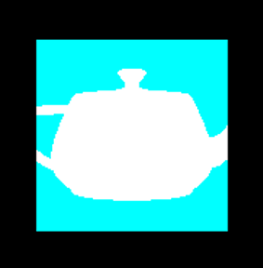
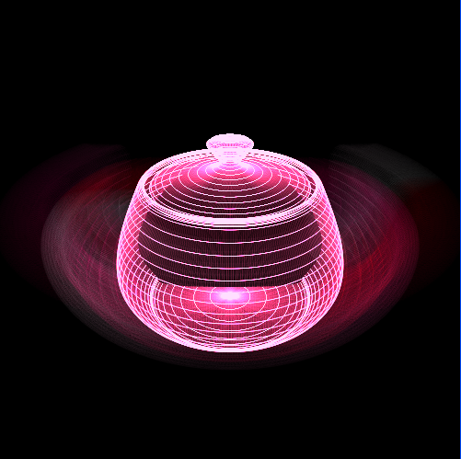
The Buffers
OpenGL allows us to modify the following buffers:
Color buffers (multiple)
contain information about the color of pixel
Depth buffer (Z buffer)
stores depth information of each pixel
(allowing closer objects to be drawn over those farther away)
Stencil buffer
extra buffer used for advanced techniques
Accumulation buffer
extra buffer used for special effects

Slide 9
Clear The Buffers
void glClearColor(GLclampf, GLclampf, GLclampf, GLclampf )
  Set the current values for use in cleaning color buffers in RGBA mode.
void glClearDepth(GLclampd)
  Set the current values for use in cleaning depth buffer.
void glClear(GLbitfield)
  Clear the specified buffers to their current clearing values.
    GL_COLOR_BUFFER_BIT
    GL_DEPTH_BUFFER_BIT
    GL_ACCUM_BUFFER_BIT
    GL_STENCIL_BUFFER_BIT

Slide 10
Completion of Drawing
void glFlush()
  Forces previously issued OpenGL commands to begin execution.
void glFinish()
  Forces previous issued OpenGL commands to complete.
void glutSwapBuffers()
  Swap front and back buffers.

Slide 11
Drawing Primitives

Slide 12
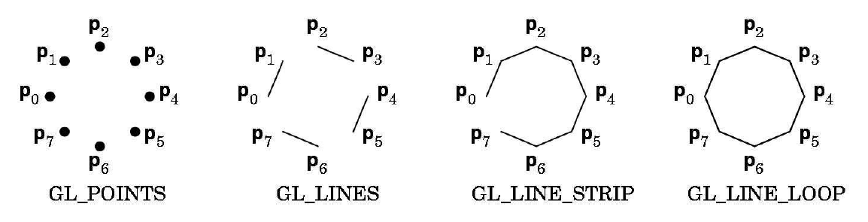
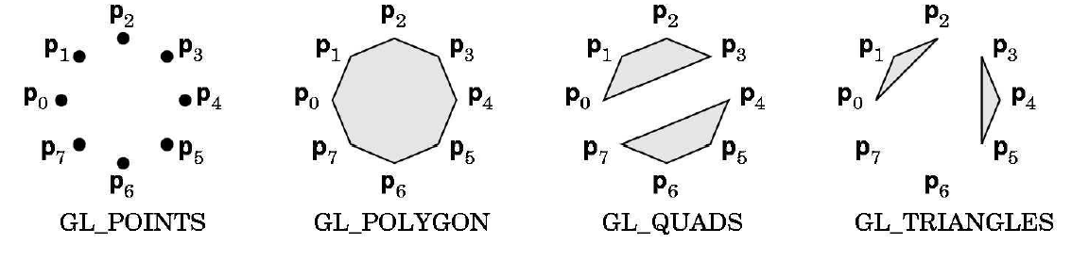
Types of Primitives

Slide 13
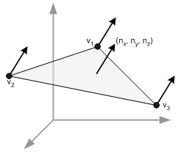
Vertex Attributes
Each vertex must be specified by at least a position (glVertex).
OpenGL has other built in attributes:
  Color
  Normal
  Texture Coordinate

Slide 14
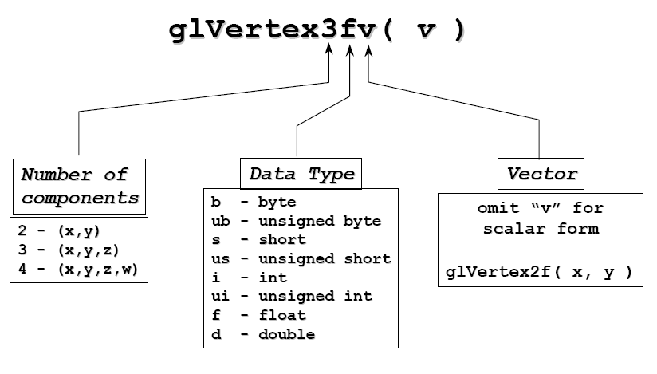
Specifying The Vertices
    Can only effective between a glBegin() and glEnd() pair
glVertex3fv

Slide 15
Color Representation
RGBA: red, green, blue, alpha
Each channel has intensity from 0.0~1.0
  Values outside this interval will be clamp to 0.0 or 1.0
  Alpha is used in blending and transparency
Specify a color:
  glColor{34}{sifd}[v](…)

Slide 16
Normal Vector
glNormal{34}{isfd}[v](TYPE* normal);
  Assign normal vector for vertices
  The normal vector should be assigned before vertex assigned
  Normal vectors must be normalize.
  OpenGL can automatically normalize normal vector by glEnable( GL_NORMALIZE )

Slide 17
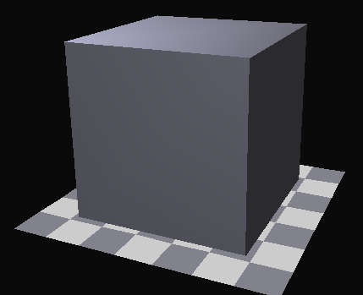
Drawing Primitives
glBegin(GL_TRIANGLES);
for (k=0;k<3;k++)
{
glTexCoord2fv(object[i]->tList[object[i]->faceList[j][k].t].ptr);
glNormal3fv(object[i]->nList[object[i]->faceList[j][k].n].ptr);
glVertex3fv(object[i]->vList[object[i]->faceList[j][k].v].ptr);
}
glEnd();
OBJ file:
v, vt, vn

Slide 18
glBegin/glEnd
Pros:
  Very simple to use for simple objects.
  Can easily specify attributes.
Cons:
  Very cumbersome to specify many objects.
  Code is verbose.
  Extremely slow.
    Several function calls per-vertex, which add up really fast.
    Have to send all vertex data from CPU to GPU every frame.

Slide 19
Vertex Arrays
  Store the vertices data in VGA memory
Pros:
  Still quite easy to use.
  Requires only a bit of setup.
  Much faster than Begin/End.
Cons:
  For client-side vertex arrays, still pretty slow.
  Still have to send all the vertex data from CPU to GPU every frame.

Slide 20
Display List
  Store the OpenGL commands
Pros:
  Very fast, sometimes fastest of any method.
Cons:
  Only works with unchanging geometry.
  Can consume a lot of GPU memory.

Slide 21
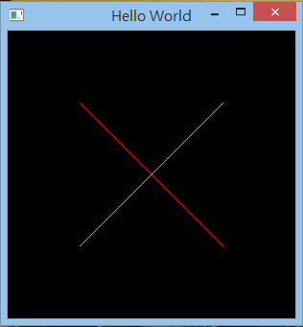
Hello World
void display()
{
//glClearColor(0.0f, 0.0f, 0.0f, 0.0f);
glClear(GL_COLOR_BUFFER_BIT);
glBegin( GL_LINES );
glColor3f(0.0f, 1.0f, 0.0f);
glVertex3f(1.0f, 1.0f, 0.0f);
glVertex3f(-1.0f, -1.0f, 0.0f);
glColor3f(1.0f, 0.0f, 0.0f);
glVertex3f(-1.0f, 1.0f, 0.0f);
glVertex3f(1.0f, -1.0f, 0.0f);
glEnd();
glFlush();
}

Slide 22
Transformations

Slide 23
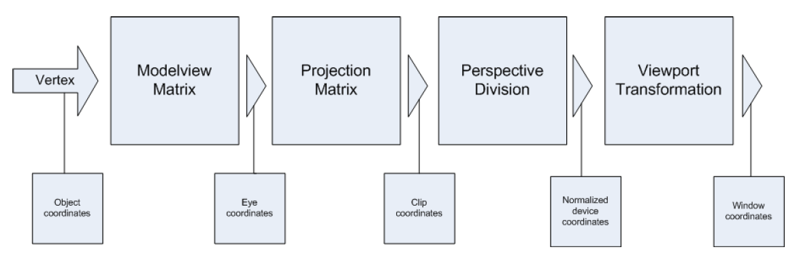
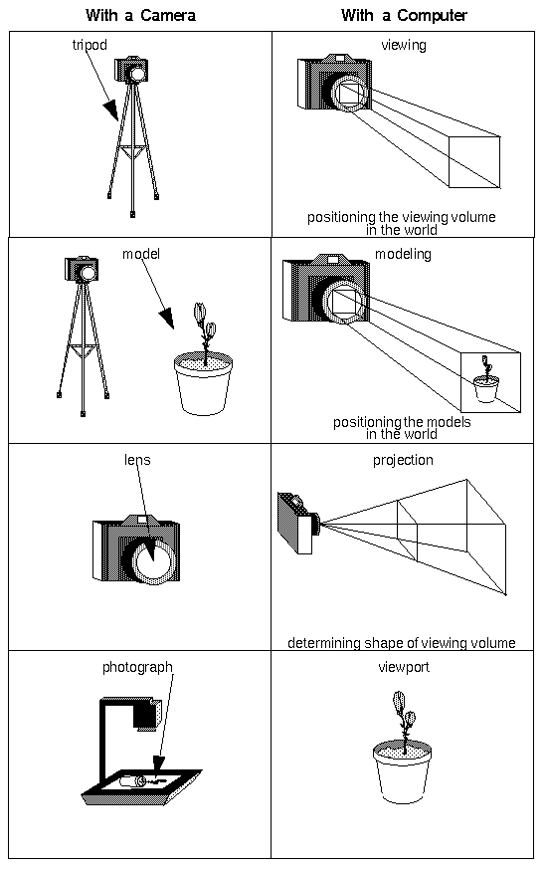


Transformations

Slide 24
Matrix Modes
Transformations in OpenGL are accomplished using matrices.
void glMatrixMode( GLenum mode );
    Each matrix mode has its own matrix stack.
ModelView Matrix (GL_MODELVIEW)
  These concern model-related operations such as translation, rotation, and scaling, as well as viewing transformations.
Projection Matrix (GL_PROJECTION)
  Setup camera projection.
Vertex
ModelView
Projection

Slide 25
ModelView Matrix
Modeling Transformation
  Perform rotate, translate, scale and combinations of these transformations
  Viewing Transformation
    To positioning and aiming the camera
In OpenGL, modeling and viewing transformation are combined into the modelview matrix before the transformation are applied.

Slide 26
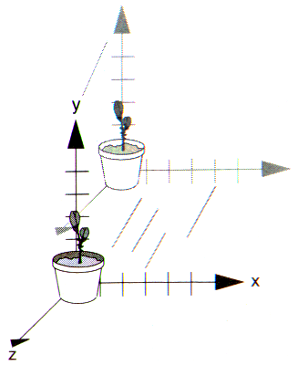
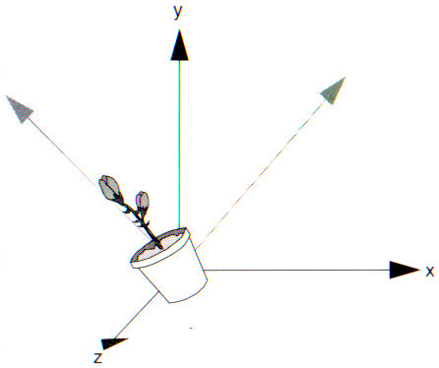
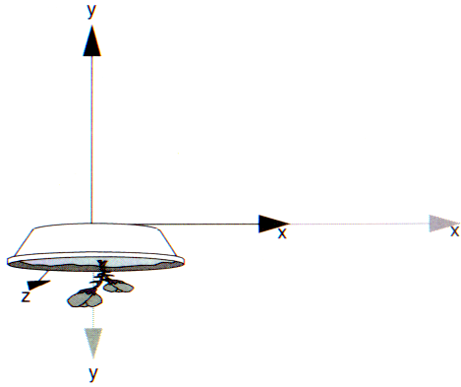
Modeling Transformation
3 basic model transformations
glTranslate{fd}( TYPE x,TYPE y,TYPE z );
glRotate{fd}( TYPR angle,TYPE x,TYPR y,TYPE z );
glScale{fd}( TYPE x,TYPE y,TYPE z );
glTranslatef( 0, 0, -1 );
glRotatef( 45.0, 0, 0, 1);
glScalef( 2.0, -0.5, 1.0 );

Slide 27
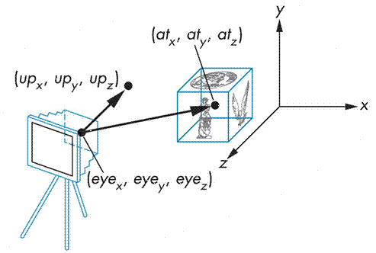
Viewing Transformation
gluLookAt( GLdouble eyex, GLdouble eyey, GLdouble eyez,
GLdouble centerx, GLdouble centery, GLdouble centerz,
GLdouble upx, GLdouble upy, GLdoubpe upz );
eye is where the camera is positioned.
center is where the camera looks at.
up is the up-vector of the camera.

Slide 28
Projection Matrix
Determine what the field of view (viewing volume) is
and how objects are projected onto the screen.
2 types of projection transformations:
Orthographic projection
  Our viewing volume is rectangular and all objects appear the same size no matter the distance
Perspective projection
  Uses perspective to give a sense of depth. Our viewing volume is conical or pyramidal in shape.

Slide 29
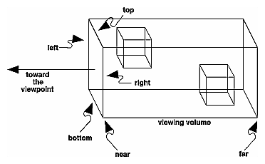
Orthographic projection
  glOrtho( GLdouble left, GLdouble right, GLdouble bottom, GLdouble top, GLdouble near, GLdouble far );
  gluOrtho2D( GLdouble left, GLdouble right, GLdouble bottom, GLdouble top);
      - Equal to calling glOrtho with near = 1 and far = 1.

Slide 30
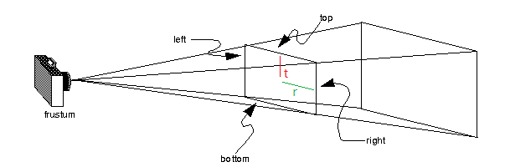
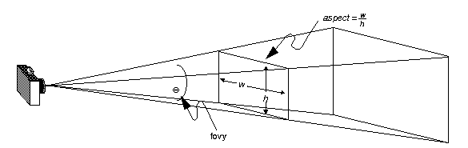
Perspective projection
  glFrustum( GLdouble left, GLdouble right, GLdouble bottom, GLdouble top, GLdouble near, GLdouble far );
  gluPerspective( GLdouble fovy, GLdouble aspect, GLdouble near, GLdouble far );

Slide 31
Viewport Transformations
void glViewport( GLint x, GLint y, GLsizei width, GLsizei height );
  Transform the final image into some region of the window
  x, y :The lower-left corner of the viewport rectangle, in pixels. The default is (0,0).
  width, height :The width and height of the viewport.
  The default is set to the dimensions of that window

Slide 32
Matrix Manipulation
Code:
glMatrixMode(GL_PROJECTION)
gluPerspective
glMatrixMode(GL_MODELVIEW)
gluLookAt
glTranslatef
glRotatef
glScalef
glBegin
glVertex3f
glEnd
Matrix Stack:
Matrix Multiplication
glVertex3f
glScalef
gluPerspective
gluLookAt
glTranslatef
glRotatef
glTranslatef
gluLookAt
glRotatef
glScalef
glVertex3f
=
Vi
gluPerspective

Slide 33
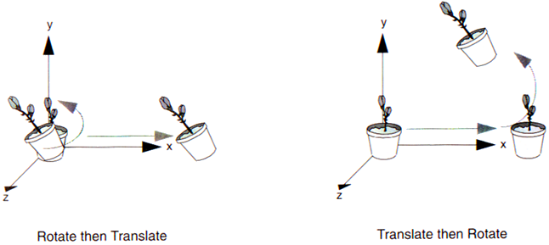
Matrix Manipulation
The order of transformations is critical.
glTranslatef( 1,0,0 );
glRotatef(45.0, 0,0,1 );
glRotatef(45.0, 0,0,1 );
glTranslatef( 1,0,0 );
drawObject();
drawObject();

Slide 34
Matrix Manipulation
glPushMatrix()
  Pushes a matrix onto the stack for later use.
glPopMatrix()
  Returns to the most recently-pushed matrix.
  These stack operations of matrix is very useful for constructing a hierarchical structure.

Slide 35
Matrix Manipulation
Push
Body
Pop
Push
Push
Push
Push
Push
head
Left hand
Right hand
Left leg
Right leg
Pop
Pop
Pop
Pop
Pop
Push
Push
Finger 1
Finger 2
Pop
Pop

Slide 36
Transformations
Modelview
Matrix
Projection
Matrix
Perspective
Division
Viewport
Transformation
Vertex
X
Y
Z
W
X
Y
eye coordinates
clip coordinates
normalized device coordinates
window coordinates
Object coordinates
TODO:
1. Switch matrix mode to GL_PROJECTION and call glLoadIdentity().
2. Call gluPerspective() if you want perspective projection.
3. Call gluOrtho() if you want orthogonal projection.
TODO:
1. Call glViewport().
TODO:
1. Switch matrix mode to GL_MODELVIEW and call glLoadIdentity().
2. Call gluLookAt().
3. Your own modeling transformations.

Slide 37
Sample Program (Dance)
void display(void)
{
glClear (GL_COLOR_BUFFER_BIT|GL_DEPTH_BUFFER_BIT);
glLoadIdentity ();
// Set look point and direct
if(!animation.zoom)
gluLookAt(50*cos(animation.viewAngle),20,50*sin(animation.viewAngle),0.0,0.0,0.0,0.0,1.0,0.0);
else
gluLookAt(25*cos(animation.viewAngle),10,25*sin(animation.viewAngle),0.0,10.0,0.0,0.0,1.0,0.0);
// Set the ballroom
baseroom();
// Set the Actors' Pose
for(unsigned int i = 0 ; i < actor.size() ; i++){
actor[i].performPose();
}
glutSwapBuffers();
}

Slide 38
Sample Program (Dance)
void reshape (int w, int h)
{
glViewport (0, 0, (GLsizei) w, (GLsizei) h);
glMatrixMode (GL_PROJECTION);
glLoadIdentity ();
if(!animation.zoom)
glFrustum(-1.0,1.0,-1.0,1.0,1.2,100.0);
else
glFrustum(-1.0,1.0,-1.0,1.0,1.2,50.0);
glMatrixMode(GL_MODELVIEW);
}

Slide 39
Lighting and Materials

Slide 40
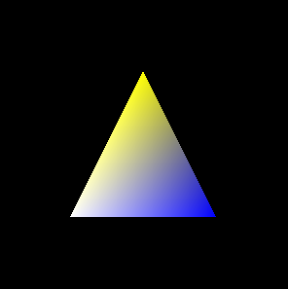

Color
Specifying shading model
void glShadeModel(GLenum mode );
    GL_FLAT / GL_SMOOTH (default)
GL_FLAT
GL_SMOOTH

Slide 41
Lighting
Enable lighting
  glEnable(GL_LIGHTING)
Enable light source
  glEnable(GL_LIGHT*)
    glEnable(GL_LIGHT0) ~ glEnable(GL_LIGHT7)
Set light property
  glLightfv(…)
Draw your object
Disable them if you don’t want to use.

Slide 42
Lighting
  void glLightfv(GLenum light, GLenum pname, GLfloat param)
Pname Def. Value Meaning
GL_AMBIENT (0.0, 0.0, 0.0, 0.0) ambient RGBA intensity of light
GL_DIFFUSE (1.0, 1.0, 1.0, 1.0) diffuse RGBA intensity of light
GL_SPECULAR (1.0, 1.0, 1.0, 1.0) specular RGBA intensity of light
GL_POSITION (0.0, 0.0, 1.0, 0.0) (x, y, z, w) position of light
GL_SPOT_DIRECTION (0.0, 0.0, -1.0) (x, y, z) direction of spotlight
GL_SPOT_EXPONENT 0.0 spotlight exponent
GL_SPOT_CUTOFF 180.0 spotlight cutoff angle
GL_CONSTANT_ATTENUATION 1.0 constant attenuation factor
GL_LINEAR_ATTENUATION 0.0 linear attenuation factor
GL_QUADRATIC_ATTENUATION 0.0 quadratic attenuation factor

Slide 43
Material
Define material properties of objects.
  void glMaterial{if}[v](GLenum face, GLenum pname, TYPE[*] param);
  face: GL_FRONT, GL_BACK, GL_FRONT_AND_BACK
Pname Def. Value Meaning
GL_AMBIENT (0.2, 0.2, 0.2, 1.0) ambient color of material
GL_DIFFUSE (0.8, 0.8, 0.8, 1.0) diffuse color of material
GL_AMBIENT_AND_DIFFUSE ambient and diffuse color of material
GL_SPECULAR (0.0, 0.0, 0.0, 1.0) specular color of material
GL_SHININESS 0.0 specular exponent
GL_EMISSION (0.0, 0.0, 0.0, 1.0) emissive color of material
GL_COLOR_INDEXES (0, 1, 1) ambient, diffuse, and specular color indices

Slide 44
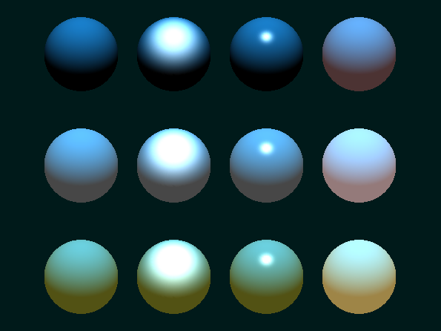
Material
No Ambient
Gray Ambient
Blue Ambient
Diffuse Only
Specular
Higher Shininess
Emission

Slide 45
Hidden-Surface Removal
Apply HSR in OpenGL
  glutInitDisplayMode(GLUT_DEPTH);
    Enable the depth buffer
  glEnable(GL_DEPTH_TEST);
    Enable depth test
  glClear(GL_DEPTH_BUFFER_BIT);
    When you wish to clean the depth buffer

Slide 46
Sample Program 1/2
void init(void)
{
glClearColor (0.0, 0.0, 0.0, 0.0);
glShadeModel (GL_SMOOTH);
// OpenGL Set light and material
GLfloat mat_diffuse[]={0.7,0.7,0.7,1.0};
GLfloat mat_ambient[]={0.7,0.7,0.7,1.0};
GLfloat mat_specular[]={1.0,1.0,1.0,1.0};
GLfloat mat_shininess[]={50.0};
GLfloat light_ambient[]={0.2,0.2,0.2,1.0};
GLfloat light_diffuse[]={1.0,1.0,1.0,1.0};
GLfloat light_position[]={1.0,1.0,1.0,0.0};

Slide 47
Sample Program 2/2
glMaterialfv(GL_FRONT,GL_SPECULAR,mat_specular);
glMaterialfv(GL_FRONT,GL_SHININESS,mat_shininess);
glMaterialfv(GL_FRONT,GL_DIFFUSE,mat_diffuse);
glMaterialfv(GL_FRONT,GL_AMBIENT,mat_ambient);
glLightfv(GL_LIGHT0,GL_POSITION,light_position);
glLightfv(GL_LIGHT0,GL_AMBIENT,light_ambient);
glLightfv(GL_LIGHT0,GL_DIFFUSE,light_diffuse);
glEnable(GL_LIGHTING);
glEnable(GL_COLOR_MATERIAL);
glEnable(GL_LIGHT0);
glEnable(GL_DEPTH_TEST);
}

Slide 48
GLUT

Slide 49
OpenGL Utility Toolkit (GLUT)
A window system-independent toolkit to hide the complexity of differing window system APIs.
Providing following operations:
  Initializing and creating window
  Handling window and input events
  Drawing basic 3D objects
  Running the program

Slide 50
How to Use GLUT?
Put these 3 files in your project directory.
  glut.h (Include it!)
  glut32.lib (Link it!)
  glut32.dll (Execute with it!)

Slide 51
Sample Program
int main(int argc, char** argv)
{
glutInit(&argc, argv);
glutInitDisplayMode (GLUT_DOUBLE | GLUT_RGB);
glutInitWindowSize (700, 500);
glutInitWindowPosition (50, 50);
glutCreateWindow (“Dance”);
init();
glutDisplayFunc(display);
glutReshapeFunc(reshape);
glutKeyboardFunc(keyboard);
glutMainLoop();
return 0;
}

Slide 52
Sample Program
int main(int argc, char** argv)
{
glutInit(&argc, argv);
glutInitDisplayMode (GLUT_DOUBLE | GLUT_RGB);
glutInitWindowSize (700, 500);
glutInitWindowPosition (50, 50);
glutCreateWindow (“Dance”);
init();
glutDisplayFunc(display);
glutReshapeFunc(reshape);
glutKeyboardFunc(keyboard);
glutMainLoop();
return 0;
}
  Initializing the GLUT library
  Should be called before any other GLUT functions

Slide 53
Sample Program
int main(int argc, char** argv)
{
glutInit(&argc, argv);
glutInitDisplayMode (GLUT_DOUBLE | GLUT_RGB);
glutInitWindowSize (700, 500);
glutInitWindowPosition (50, 50);
glutCreateWindow (“Dance”);
init();
glutDisplayFunc(display);
glutReshapeFunc(reshape);
glutKeyboardFunc(keyboard);
glutMainLoop();
return 0;
}
Specify the display Mode
GLUT_RGB / GLUT_RGBA / GLUT_INDEX
GLUT_SINGLE / GLUT_DOUBLE
GLUT_DEPTH / GLUT_STENCIL / GLUT_ACCUM

Slide 54
Sample Program
int main(int argc, char** argv)
{
glutInit(&argc, argv);
glutInitDisplayMode (GLUT_DOUBLE | GLUT_RGB);
glutInitWindowSize (700, 500);
glutInitWindowPosition (50, 50);
glutCreateWindow (“Dance”);
init();
glutDisplayFunc(display);
glutReshapeFunc(reshape);
glutKeyboardFunc(keyboard);
glutMainLoop();
return 0;
}
Create a window Named “Dance”
with position (x, y)
with size (width, height)

Slide 55
Sample Program
int main(int argc, char** argv)
{
glutInit(&argc, argv);
glutInitDisplayMode (GLUT_DOUBLE | GLUT_RGB);
glutInitWindowSize (700, 500);
glutInitWindowPosition (50, 50);
glutCreateWindow (“Dance”);
init();
glutDisplayFunc(display);
glutReshapeFunc(reshape);
glutKeyboardFunc(keyboard);
glutMainLoop();
return 0;
}
Your OpenGL initialization code (Optional)

Slide 56
Sample Program
int main(int argc, char** argv)
{
glutInit(&argc, argv);
glutInitDisplayMode (GLUT_DOUBLE | GLUT_RGB);
glutInitWindowSize (700, 500);
glutInitWindowPosition (50, 50);
glutCreateWindow (“Dance”);
init();
glutDisplayFunc(display);
glutReshapeFunc(reshape);
glutKeyboardFunc(keyboard);
glutMainLoop();
return 0;
}
Register your call back functions

Slide 57
Sample Program
int main(int argc, char** argv)
{
glutInit(&argc, argv);
glutInitDisplayMode (GLUT_DOUBLE | GLUT_RGB);
glutInitWindowSize (700, 500);
glutInitWindowPosition (50, 50);
glutCreateWindow (“Dance”);
init();
glutDisplayFunc(display);
glutReshapeFunc(reshape);
glutKeyboardFunc(keyboard);
glutMainLoop();
return 0;
}
The program goes into an infinite loop waiting for events

Slide 58
GLUT Callback Functions
Callback function : Routine to call when an event happens
  Window resize or redraw
  User input
    - (mouse, keyboard)
  Animation
    - (render many frames)
Keyboard
Event queue
….
MainLoop()
Mouse
Window
Mouse_callback()
{
….
{
Keypress_callback()
{
….
{
window_callback()
{
….
{

Slide 59
Events in OpenGL
Event | Example | OpenGL Callback Function
Keypress | KeyDown KeyUp | glutKeyboardFunc
Mouse | leftButtonDown leftButtonUp | glutMouseFunc
Motion | With mouse press Without | glutMotionFunc glutPassiveMotionFunc
Window | Moving Resizing | glutReshapeFunc
System | Idle Timer | glutIdleFunc glutTimerFunc
Software | What to draw | glutDisplayFunc

Slide 60
GLUT Functions
void glutDisplayFunc(void (*func)(void));
  Called whenever the contents of the windows need to be redrawn.
  Put whatever you wish to draw on screen here.
  Use glutPostRedisplay() to manually ask GLUT
  to recall this display function
void glutReshapeFunc(void (*func)(int width, int height));
  Called whenever the window is resized or moved.
  You should always call glViewport() to resize your viewport.

Slide 61
GLUT Functions
void glutTimerFunc(unsigned int msecs, void (*func)(int value), value);
  Register the timer callback func to be triggered in at least msecs milliseconds..
  The value parameter to the timer callback will be the value of the value parameter to glutTimerFunc.
void glutKeyboardFunc(void (*func)(unsigned char key, int x, int y));
  Sets the keyboard callback for the current window.

Slide 62
Sample Program
void keyboard (unsigned char key, int x, int y)
{
switch (key) {
//Many control cases ...
// Start the animation
case '=':
music.Play();
glutTimerFunc(_START_DELAY_, OnTimer, 1);
break;
}
glutPostRedisplay();
}

Slide 63
Sample Program
void OnTimer(int value)
{
if(animation.frameIndex < script[0]->frameNumber()) {
// invoke the next frame
glutTimerFunc(_TIME_INTERVAL_, OnTimer, 1);
/* animation playing */
}
else {
/* animation end */
}
glutPostRedisplay();
return;
}

Slide 64
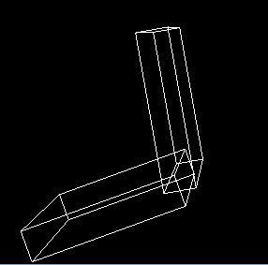
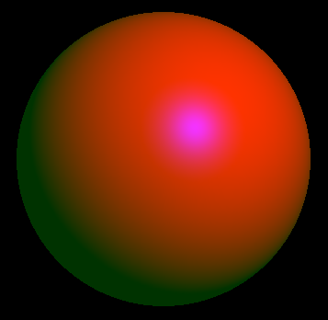
GLUT Objects
GLUT provides the follow objects:
  sphere, cube, torus, icosahedron, octahedron,
  tetrahedron, teapot, dodecahedron, cone.
  Both wireframe and solid
  Ex: glutSolidSphere(1.0, 24, 24)
  Ex: glutWireCube(1.0)
  https://www.opengl.org/resources/libraries/glut/spec3/node80.html

Slide 65
Appendix: Example of Mouse Callback Function
void glutMouseFunc(void (*func)(int button, int state, int x, int y));
int startX, startY;
void mouse(int button, int state, int x, int y){
if (state == GLUT_DOWN){
startX = x;
startY = y;
}
else if(state == GLUT_UP){
printf("the mouse moves %d %d \n", x - startX, y - startY);
}
}

Slide 66
Appendix: Example of Motion Callback Function
void glutMotionFunc(void (*func)(int x, int y));
void motion(int x, int y){
printf("the mouse is moving to %d %d", x, y);
}

