Slide 1
VR Appendix 1 Oculus rift dk2
歐陽明 教授
Ming Ouhyoung

Slide 2
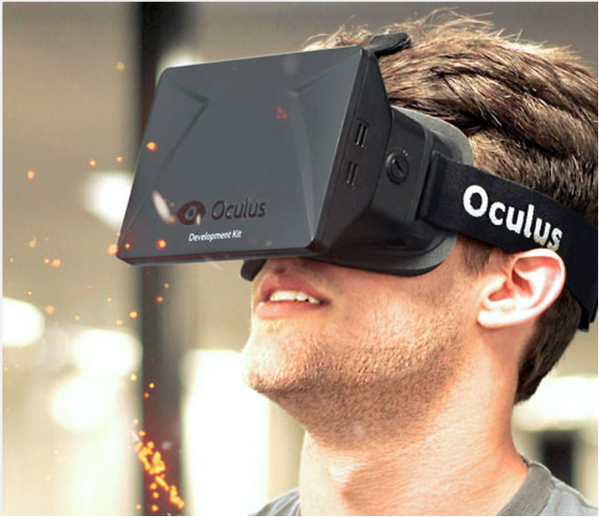
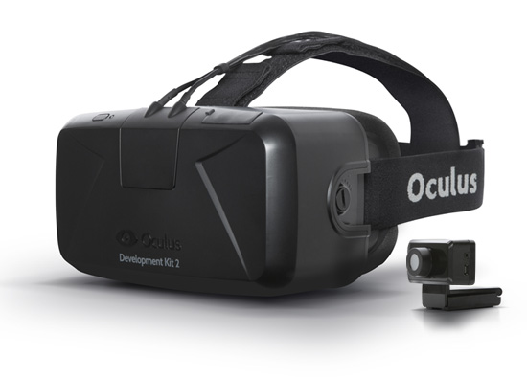
Oculus rift & rift DK2

Slide 3
Specification
Resolution | 960 x 1080 per eye
Viewing Optics | 100° Field of View (nominal)
Sensors: Gyroscope, Accelerometer, Magnetometer

Slide 4
Low Persistence OLED Display
DK2 uses a low persistence OLED display to eliminate motion blur and judder, two of the biggest contributors to simulator sickness. Low persistence makes the scene appear visually stable, increasing the potential for presence.

Slide 5
Low Latency: Built-In Latency Tester
Oculus has built a latency testing system into DK2. Real-time microsecond precision measurement of motion-to-photon latency lets you optimize your VR experience.

Slide 6
Outline:
Will VR Meet Your goals ?
Is VR the Appropriate Medium ?
What Makes an Application a Good Candidiate for VR?
Creating a VR Application.
Adapting from other Media.

Slide 7
Will VR Meet Your goals ?
Safety
Marketing
Cost savings
Profit

Slide 8
Conveying ideas as artistic expression
Improved ability to examine and
explore 3D data
Entertainment or escapism
Improved quality of life

Slide 9

Is VR the Appropriate Medium?
Moby Dick(or The Whale)
Citizen Kane
Directed by Orson Welles

Slide 10
What Makes an Application a Good Candidiate for VR?
A key component of VR : real time interface.
VR relies on a 3-D environment, tasks that are inherently 1-D or 2-D are not likely take advantage of VR.
The imprecision and lag in current tracking methods, as well as relatively slow computation, makes tasks that require a very close registration with the real world a difficult targets.

Slide 11
Most VR devices are oriented toward visual and audio display. Because of this, there has been less work done for applications which use haptic display.

Slide 12
There are many problems for which the same benefits and problem solving capabilities of simulation can be extended to the medium of VR.
Problems that cannot be tackled in the physical
world.
Problems that cannot be studied safely.
Problems that cannot be experimented with due to cost constraints.
Problems in “What if?” studies.

Slide 13
Creating a VR Application
How ?
Familiarize yourself with the medium of VR to the greatest extent feasible .
VR experiences .
VR hardware devices .
You may derive your VR experience from three sources (1)another medium , (2) an existing VR application , (3) scratch .

Slide 14
Adapting from Other Media
It often does not work to indiscriminately transfer content from old medium to VR:
In transferring a book to a movie, a screenwriter adapts the narrative from the textual to the visual.
VR is an inherently an interactive medium; therefore, the simple transference of content from sequential media makes little sense.

