Slide 1
VR Appendix 2
Google Cardboard VR
歐陽明 教授
Ming Ouhyoung

Slide 2
It seems that VR/AR is just going through the Cambrian explosion!
(寒武紀大爆發)
Google glass (failed product)
Oculus Rift/Rift 2 (purchased by Facebook)
Google Cardboard VR project
Microsoft HoloLens project
all these happened in 2014/2015!

Slide 3
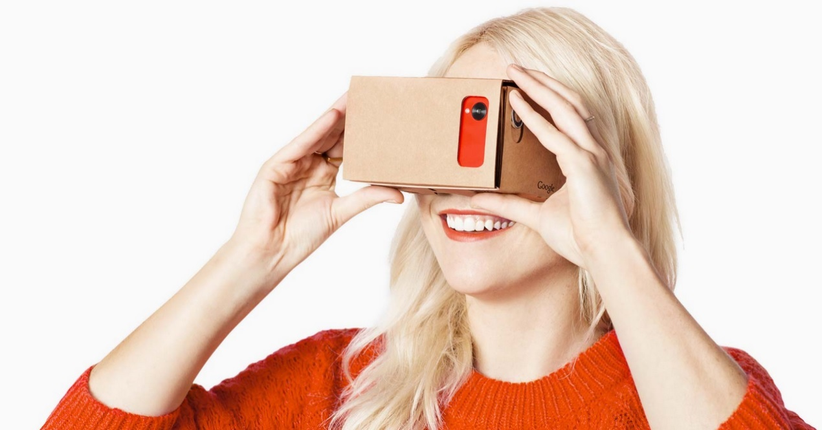
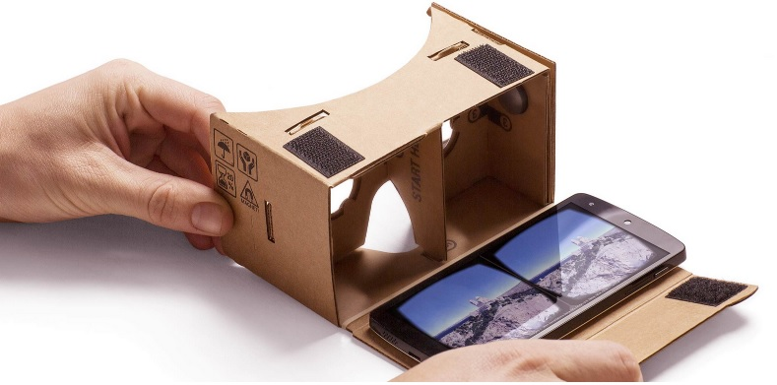
Extremely cheap HMD: US$6-20

Slide 4
Half a million sold in one week!
(December 16, 2014 news)
Less than a week after going on sale and dropping rather quietly on an unsuspecting America, Project Cardboard has rocketed past the 500,000 sales mark. Such is the popularity of the DIY virtual reality toy that Google has even built and launched a dedicated area of the Play Store for apps created for or ideally suited for use with the unusual piece of facewear.

Slide 5
Why so popular?
“The growth of mobile, and the acceleration of open platforms like Android make it an especially exciting time for VR,” beamed Andrew Nartker, project manager for Google Cardboard.

Slide 6
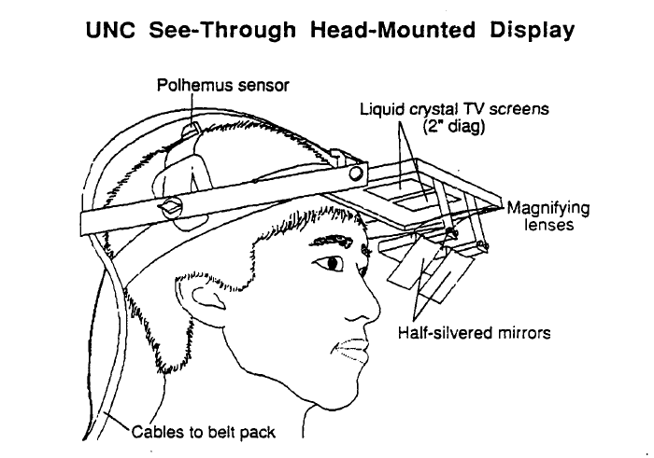
30 years from UNC HMD: much cheaper! (Display, Sensors)
Polhemus position/orientation sensor: US$2000, 25 years ago.
Display: LCD TV screens: US$400 per set, and need 2 of them!

Slide 7
Polhemus trackers
Polhemus pioneered the original AC electromagnetic head tracking in the late 1960's and has advanced the technology in tracking excellence ever since.
full six-degrees-of-freedom (6DOF) motion tracking
Our latest head/helmet tracker is SCOUT--the world's only 6DOF self contained head tracker. We are proud to offer our customers the low risk, high minimal cockpit mounted equipment, no line-of-sight limitations and an ultra small lightweight and embeddable helmet sensor. SCOUT is currently in full rate production and is fielded and flying on A-10, F-16, C-130 aircraft. It's the trusted choice for world-class pilots.

Slide 8
Android Apps
For HTC, Samsung, Xiaomi Inc. etc.: best VR Apps,
1. Cardboard VR app
2. Cosmic Rollercoaster VR app
3. Jurassic Dino VR
4. VR Cinema (just choose a video, and play using this app)
5. Crazy Swing VR
6. Rollercoaster VR
7. Space Terror (need Bluetooth controller to play)

Slide 9
iOS Apps
For iPhone 4, iPhone 5, iPhone 6, and 6 plus, iPad, iPad Air,
1. Stereotunnel, (2x play, 3D mode, ok)
2. City Rollercoaster (Best effects, ok)
3. Moorente, (not ok for small stereo)
4. DiveZombie (not ok)
5. Appartment (need additional Bluetooth controller)
6. VR sport (need controller)
7. The Height

Slide 10
3D Video from Youtube
Key word: 3D trailers for 3D glasses
Example titles:
Air Racers, real airplane stunt show
Samsung 3D demo
Sly cooper
WoW, World of Warcraft
Finding Nimos, is one good example,

Slide 11
HMD User Manual
You can wear eyeglasses
A movable magnet (ring) at the left side, which is a controller button (sliding down)
For some smartphones, such as from Samsung, place the movable magnet (ring) at the RIGHT side.
Rotate the HMD 90 degrees will sometimes reset the application, such as in “Cardboard VR app”

Slide 12
Influence of the future smartphones, a projection
In the past, GPUs in phones are not really important, VIDEO codes are more important! (Flicker, Youtube Inc.)
Now, heterogeneous systems (CPU+GPU) are increasingly important, a must! (VR, AR)
New sensors (position sensor, roll sensor) needed, probably as additional NFC/Bluetooth devices.
Higher resolution (toward 4x by 4k x2)

Slide 13
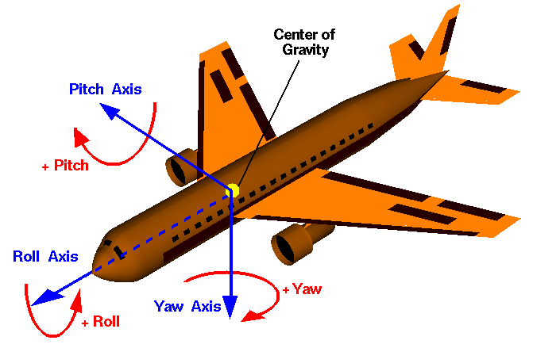
Definition of Roll, Pitch, Raw

Slide 14
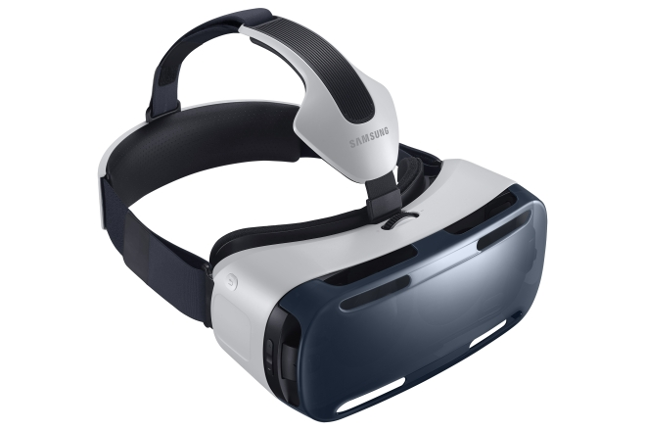
More choices: Gear VR by Oculus (US$199.), and from HTC!

Slide 15
Spec.
  96˚ Field of View
Sensor:
  Accelerator, Gyrometer, Geomagnetic, Proximity
Motion to Photon Latency: < 20ms
Focal Adjustment:
  Covers Nearsighted / Farsighted Eyes
Interpupillary Distance Coverage
  55 ~ 71 mm

Slide 16
Gear VR with Samsung Galaxy Note 4
Display:
  5.7 inch (143.9mm) Quad HD Super AMOLED (2560×1440)
Physical User Interface
  Touch Pad, Back Button, Volume Key
Audio:
  3D Spatial Sound on Samsung VR Player for VR Gallery contents
  (Earphone needed)

Slide 17
END

Slide 18
AR + VR
Microsoft Inc. HoloLens Project, Windows 10, Holographics Live Demo
https://www.youtube.com/watch?v=kCMxBw-utEY&feature=youtu.be
https://www.youtube.com/watch?v=vsKMi1377cU

Slide 19
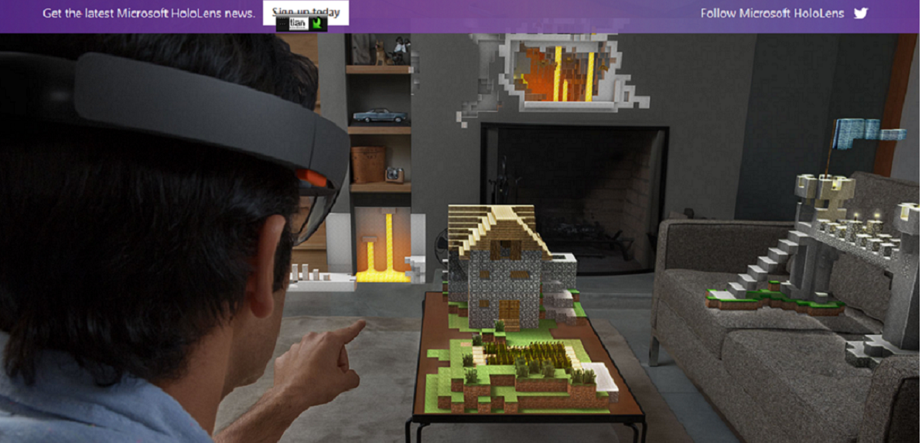
HoloLens Project

Slide 20
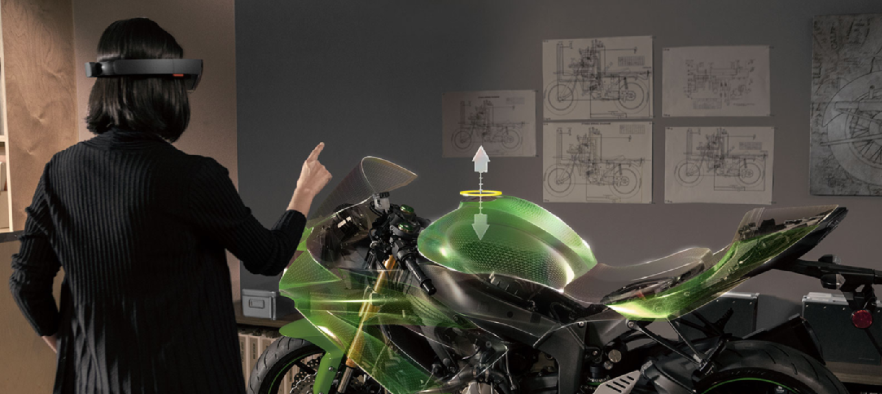

Slide 21
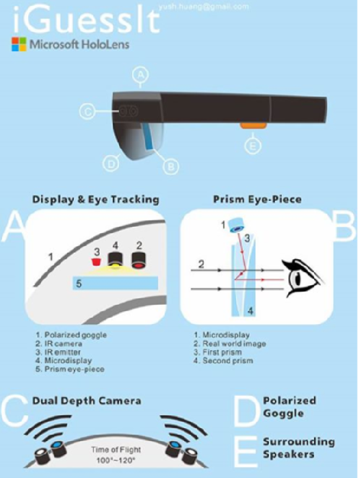
Technology reverse engineering
(by Yu-shuan Huang)
It is an optical see-through AR,
but not really Holography
Very similar to Google Glass and Epson Moverio

