Slide 1

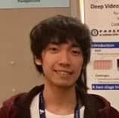
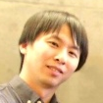
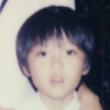
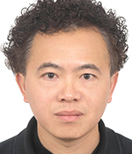

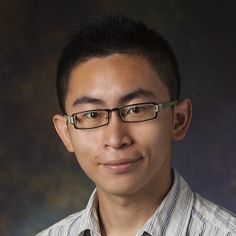
Single-Image HDR Reconstruction by Learning to Reverse the Camera Pipeline
Yu-Lun Liu^{1,2*} Wei-Sheng Lai^{3*} Yu-Sheng Chen¹ Yi-Lung Kao¹ Ming-Hsuan Yang^{3,4} Yung-Yu Chuang¹ Jia-Bin Huang⁵
¹National Taiwan University ²MediaTek Inc. ³Google ⁴UC Merced ⁵Virginia Tech
Notes:
大家好, 我是來自台大與聯發科技的劉育綸,今天很榮幸可以跟大家分享這篇paper, title是Single-Image HDR Reconstruction by Learning to Reverse the Camera Pipeline, 共同作者有台大的陳育聖, 高以龍, 莊永裕教授, UC merced的賴威昇, 楊明玄教授, 以及Virginia Tech的黃嘉賓教授

Slide 2
Problem specification
Notes:
首先先說明一下這個問題

Slide 3
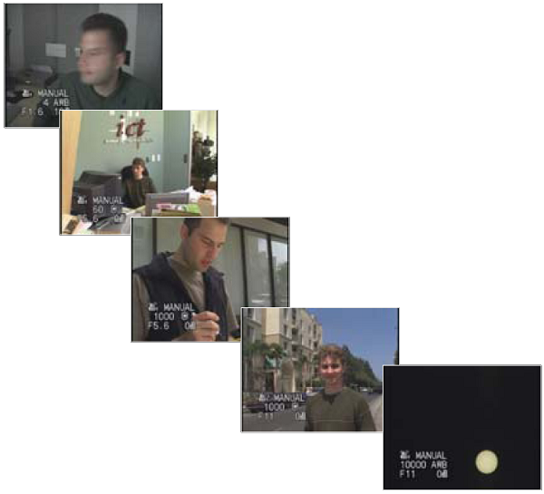
The world is high dynamic range
Motivation
1
1,500
25,000
400,000
2,000,000,000
Materials shamelessly stolen from Prof. CYY’s VFX course slides
Notes:
我們所存在的這個真實世界裡的場景能量分布具有非常大的動態範圍, 例如直視太陽所接收到的能量會是在一個陰暗房間中的10的九次方倍之多

Slide 4
Camera is an imperfect device
Motivation
10⁻⁶
10⁶
dynamic range
Real world
radiance
10⁻⁶
10⁶
Picture
intensity
^{Pixel value 0 to 255}
Materials shamelessly stolen from Prof. CYY’s VFX course slides
Notes:
但另一方面, 相機是一個無法完美測量場景能量分布的設備，它由於sensor設計的局限性所以無法capture全部光譜內容和動態範圍。

Slide 5
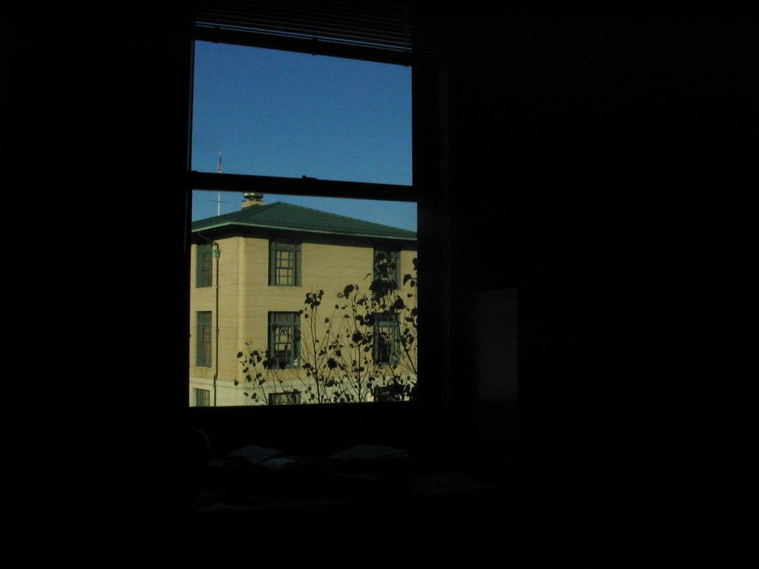
Short exposure
Motivation
10⁻⁶
10⁶
dynamic range
Real world
radiance
10⁻⁶
10⁶
Picture
intensity
^{Pixel value 0 to 255}
Materials shamelessly stolen from Prof. CYY’s VFX course slides
Notes:
所以我們能夠使用的折衷方式是: 要馬擷取高能量的部分, 但capture下來的影像就會整體偏暗

Slide 6
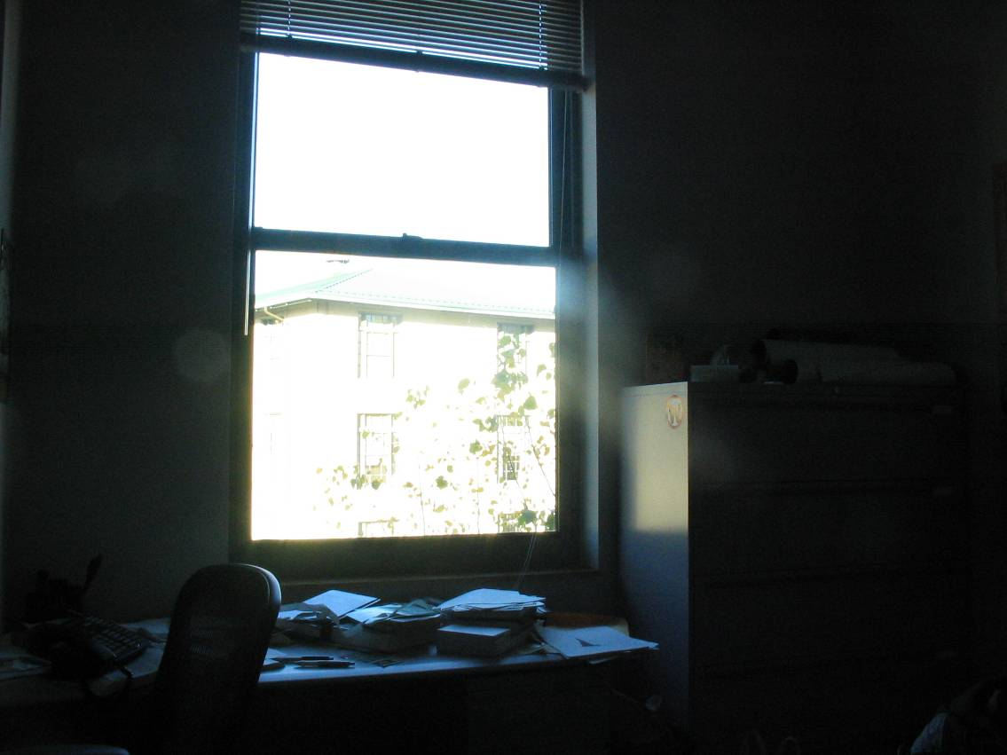
Long exposure
Motivation
10⁻⁶
10⁶
dynamic range
Real world
radiance
10⁻⁶
10⁶
Picture
intensity
^{Pixel value 0 to 255}
Materials shamelessly stolen from Prof. CYY’s VFX course slides
Notes:
要馬擷取低能量的部分, 但高光區就會過曝

Slide 7
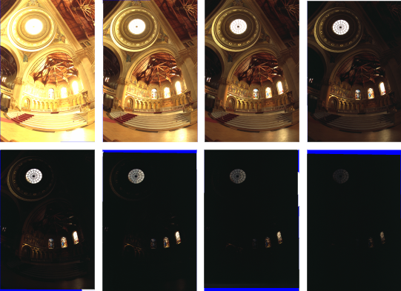
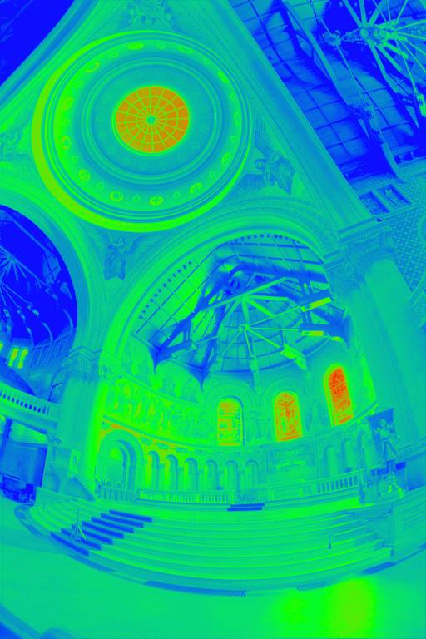
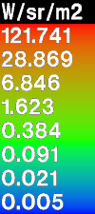
Motivation
Solution of limited dynamic range -> Use multiple exposures
Materials shamelessly stolen from Prof. CYY’s VFX course slides
Notes:
那有沒有甚麼辦法可以增加拍攝影像的動態範圍呢? 一種解決的方法就是對同一個場景拍攝多重曝光, 例如對這個例子中的教堂拍攝8張從亮到暗的照片, 並使用演算法將這些不同曝光的照片融合成一張HDR影像, 這張HDR影像就代表了整個場景的真實能量分布

Slide 8
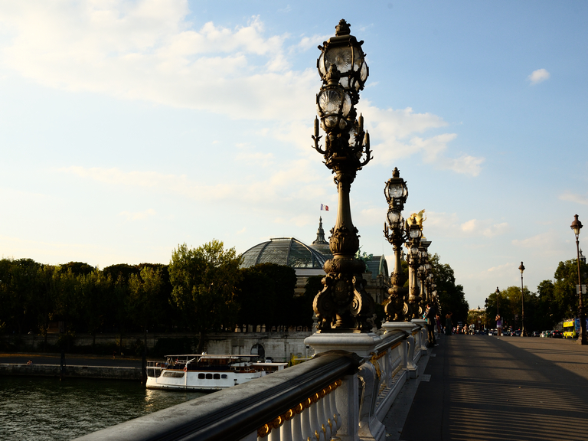
Problem
However, most existing images are captured with a single exposure
Input LDR image
Notes:
然而, 大多數已經被拍攝好的影像都是單一曝光, 例如當時有一位攝影師可能覺得這個時間這個氣氛讓這個場景非常完美, 於是他拍攝了這張照片

Slide 9
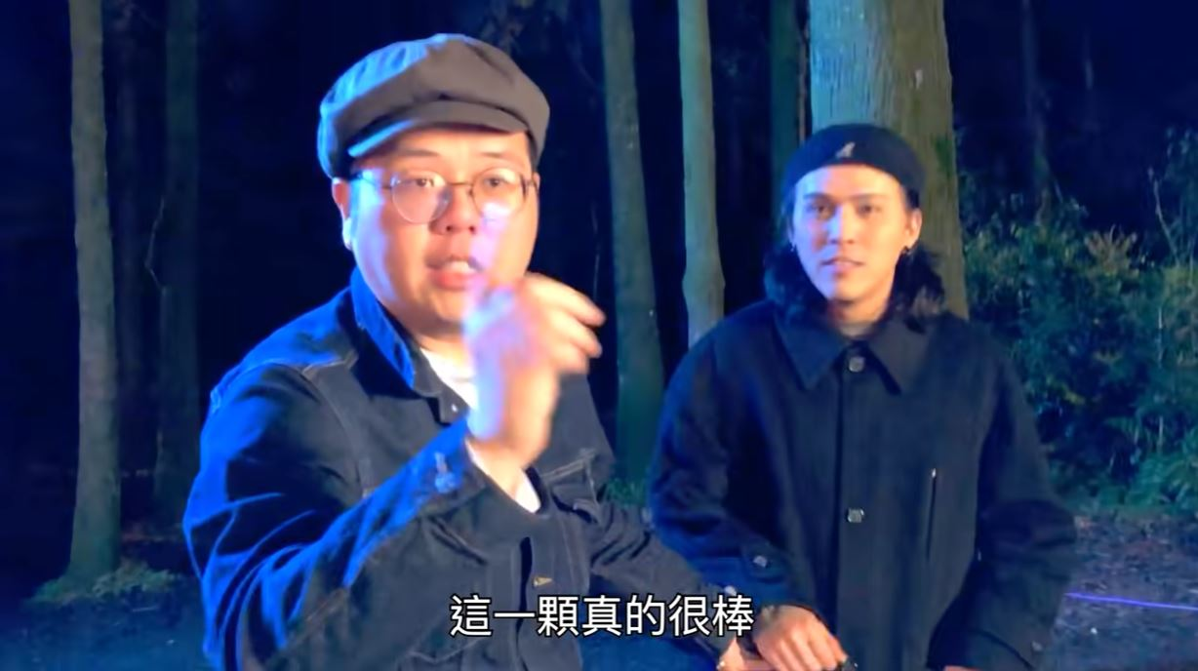

Problem
However, most existing images are captured with a single exposure
Input LDR image
Notes:
而攝影師已經再也無法回到那個時間那個地點去拍攝那個場景的多重曝光

Slide 10
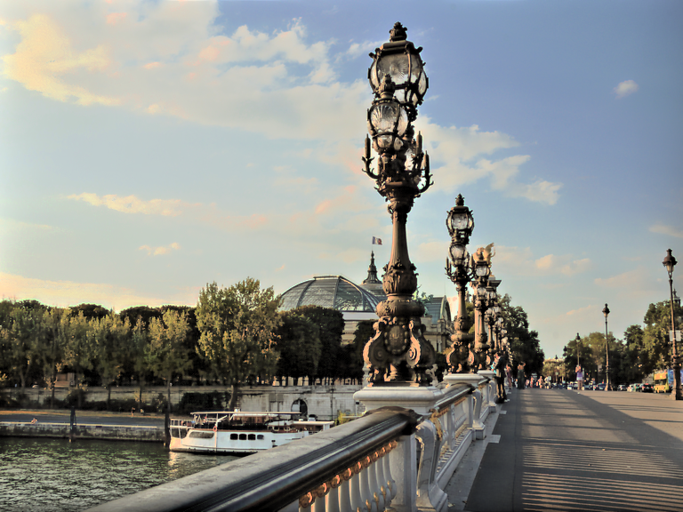
Problem
However, most existing images are captured with a single exposure
Single-image HDR reconstruction
Input LDR image
Output HDR image
Notes:
這時候如果我們有single image HDR reconstruction這種演算法, 就可以把這張LDR影像變成一張HDR

Slide 11
Challenges
Over-exposed
Single-image HDR reconstruction
Under-exposed
Input LDR image
Output HDR image
Notes:
那由於input LDR影像缺少欠曝和過曝區域的細節, 所以從單張LDR影像還原HDR是一個非常具有挑戰性的問題

Slide 12
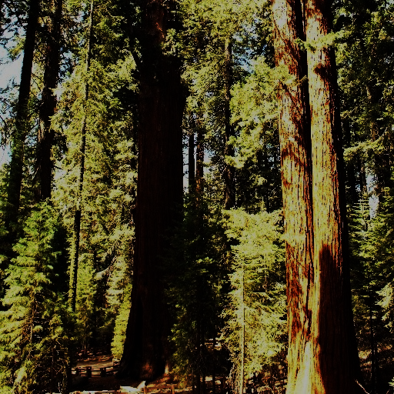
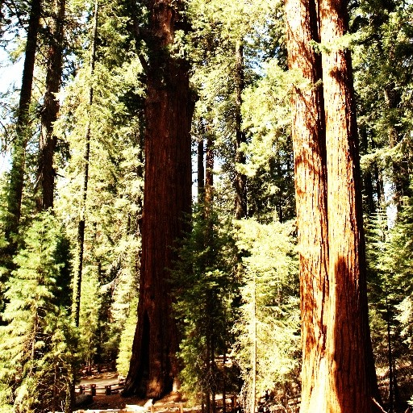
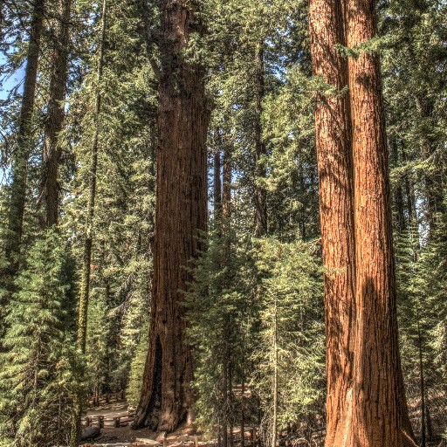
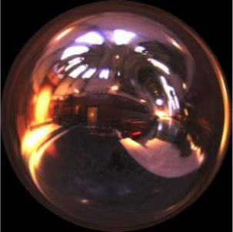
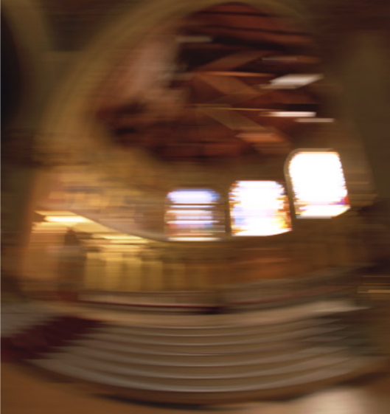
What is HDR reconstruction for?
Input LDR image
Output HDR image
CNN
Tone-mapping
Image-based lighting
Motion blur synthesis
Notes:
而重建出來的HDR影像有許多應用, 例如tone-mapping成人眼覺得好看的影像, 或是當作環境光來為電腦繪圖做打光, 甚至是合成真實的camera motion blur

Slide 13
Related work
Notes:
那接著我們介紹一下single-image HDR reconstruction近年來相關的work

Slide 14
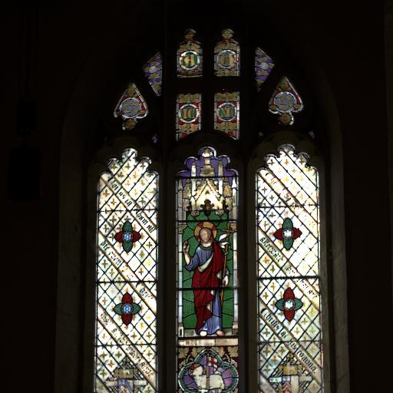
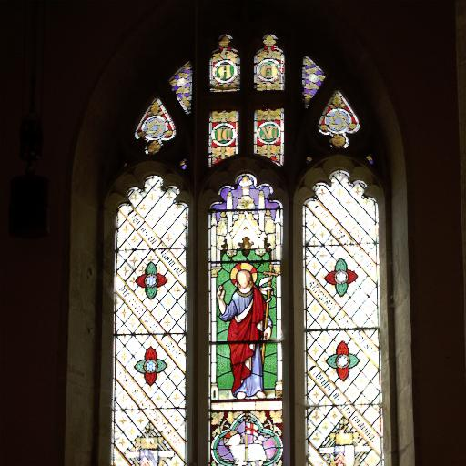
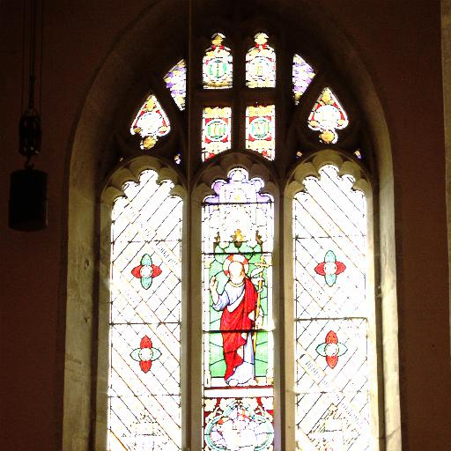
Related work
CNN
Fusion
[Debevec and Malik 1997]
LDR
Exposure bracketing
HDR
DrTMO [Endo et al., SIGGRAPH ASIA’17]
Notes:
17年的DrTMO提出了使用CNN來預測多重曝光的影像, 後面再用傳統的HDR fusion算法來將這些多重曝光的影像融合成一張HDR

Slide 15
Related work
CNN
Fusion
[Debevec and Malik 1997]
LDR
Exposure bracketing
HDR
DrTMO [Endo et al., SIGGRAPH ASIA’17]
Cannot be optimized in an end-to-end fashion
Notes:
但也因為HDR是由一個傳統方法產生的, 所以DrTMO並沒有辦法end-to-end training來最佳化HDR的quality

Slide 16
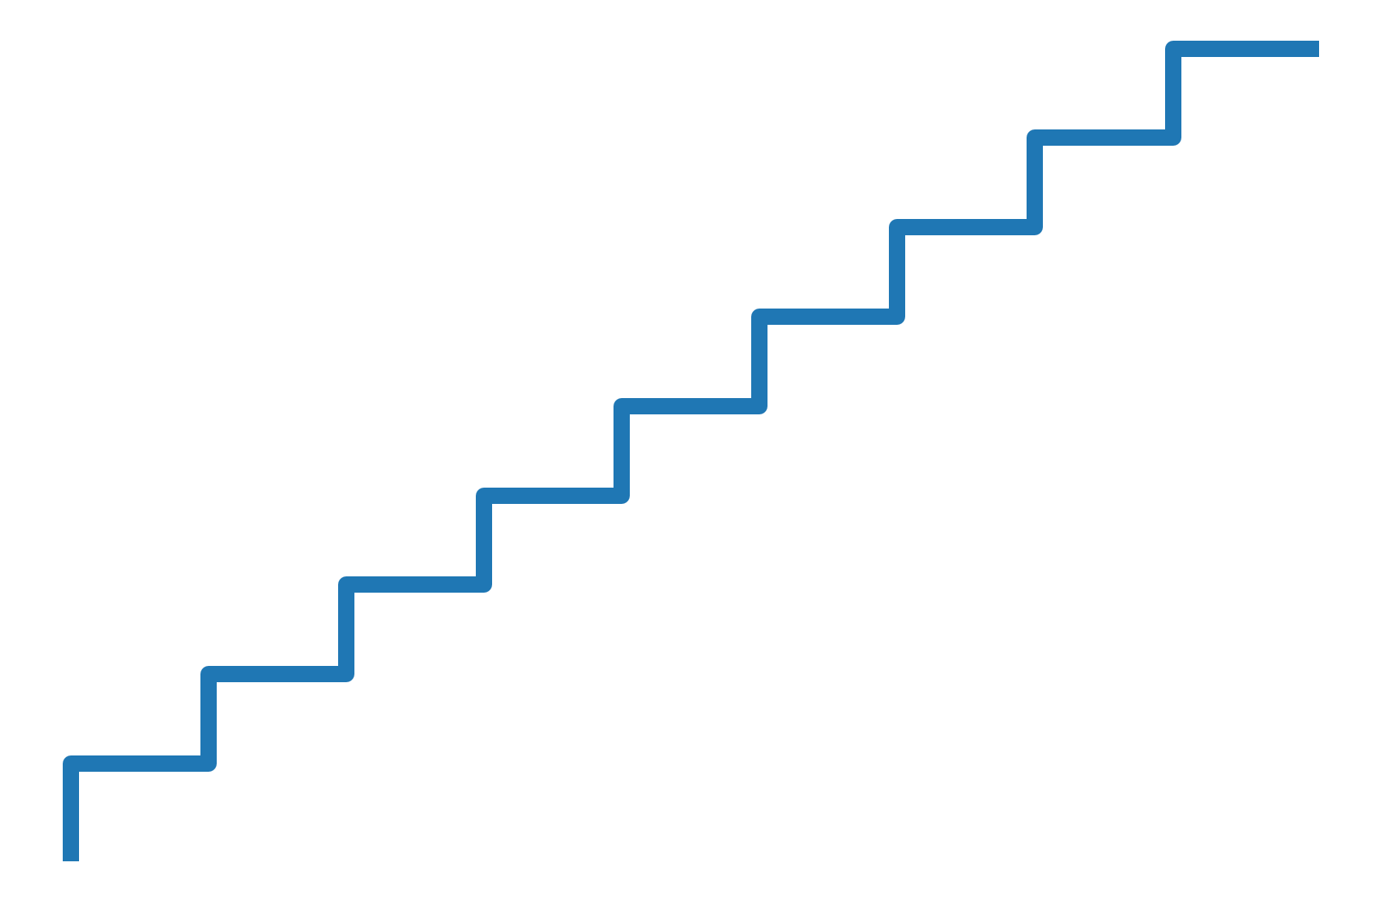
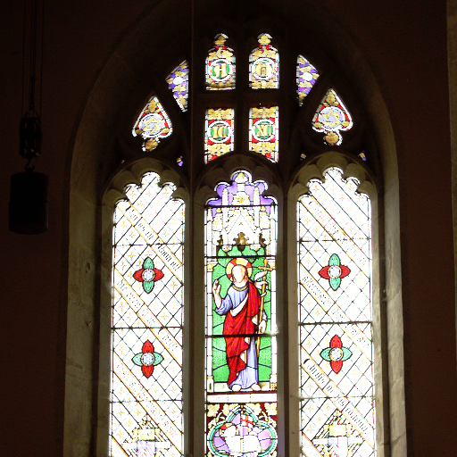

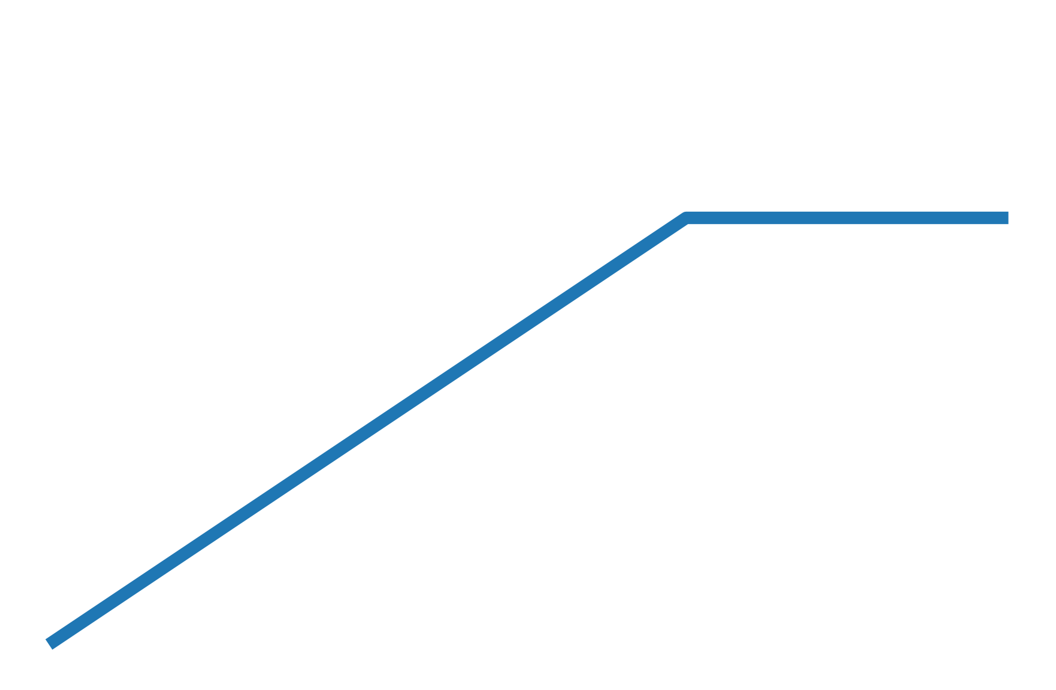
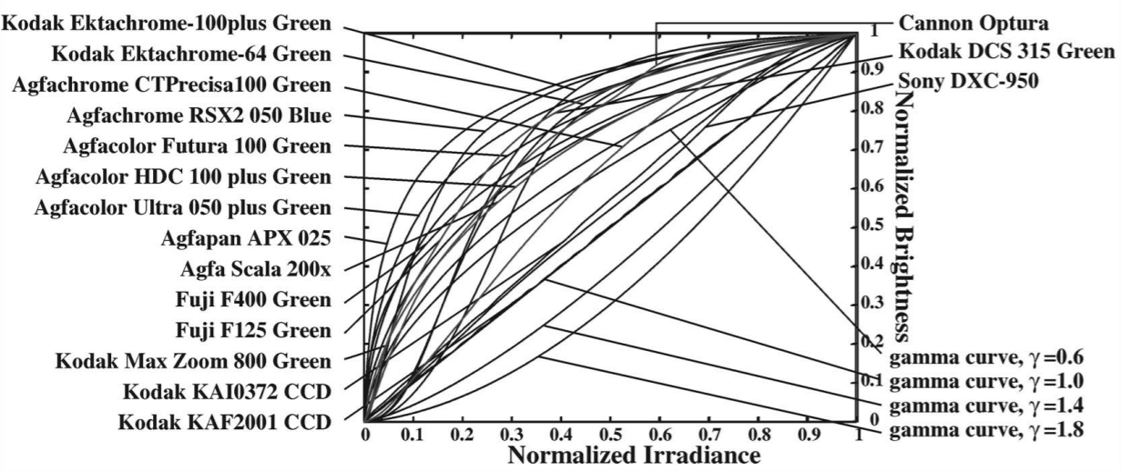
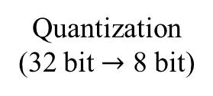
LDR Image formation pipeline
intensity
intensity
CRF
irradiance
LDR
intensity
Non-linear LDR
irradiance
Linear LDR
irradiance
HDR
Quantization
(32 bit $→$ 8 bit)
Non-linear mapping
Dynamic range clipping
量化到8 bit
轉換成適合人看的色調
高光區過曝
Notes:
那在介紹更近期的related work之前, 我們先說明一張LDR影像, 是如何由HDR經過相機中pipeline產生的, 一開始我們從一張代表著場景真實能量分布的HDR出發
由於相機sensor所能容納的最大光子數量的限制, 所以超過這個範圍的能量被clip掉而產生影像中的過曝區
接著這張linear LDR會經過相機內部的camera response function CRF轉換到non-linear domain, 而每一種相機的CRF都不一樣, 甚至對每一個場景都是動態改變的
最後會將這個已經轉到non-linear domain的LDR影像經過quantization到8個bit後儲存成我們所熟悉的PNG或是JPG LDR影像

Slide 17
LDR Image formation pipeline
intensity
intensity
irradiance
LDR
intensity
Non-linear LDR
irradiance
Linear LDR
irradiance
HDR
Quantization
(32 bit $→$ 8 bit)
Non-linear mapping
Dynamic range clipping
CNN
LDR
ExpandNet [Marnerides et al., Eurographics’18]
HDR
Notes:
18年ExpandNet提出了直接硬train一個LDR to HDR的CNN

Slide 18
LDR Image formation pipeline
intensity
intensity
irradiance
LDR
intensity
Non-linear LDR
irradiance
Linear LDR
irradiance
HDR
Quantization
(32 bit $→$ 8 bit)
Non-linear mapping
Dynamic range clipping
CNN
LDR
ExpandNet [Marnerides et al., Eurographics’18]
HDR
Implicitly learns everything, cannot generalize well
Notes:
但直接用一個CNN來model所有的non-linear操作使得他沒有辦法generalize得很好

Slide 19
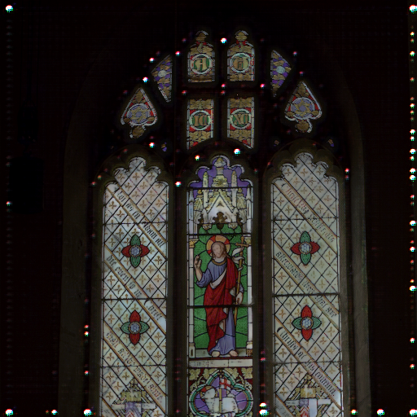
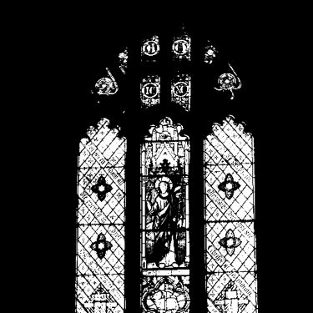
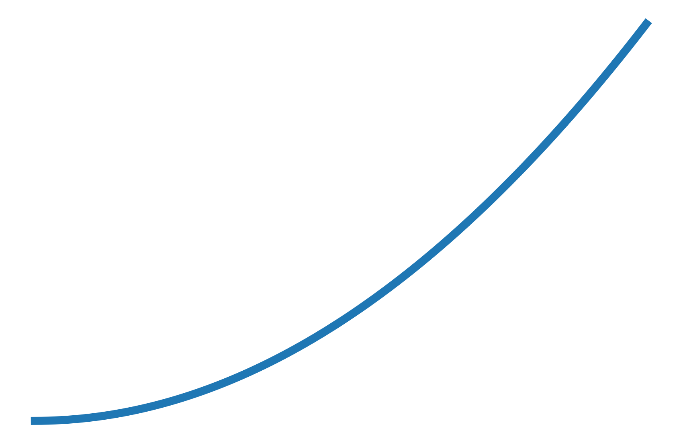
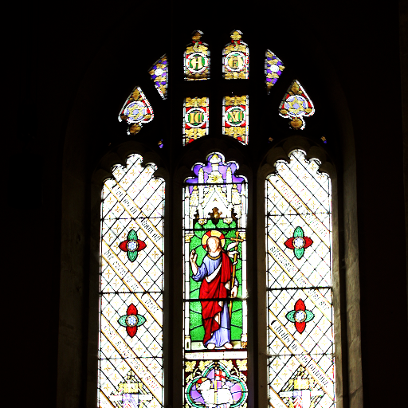
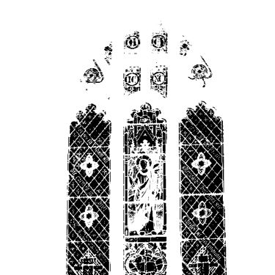


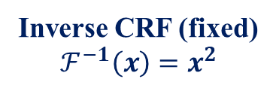


LDR Image formation pipeline
intensity
intensity
irradiance
LDR
intensity
Non-linear LDR
irradiance
Linear LDR
irradiance
HDR
Quantization
(32 bit $→$ 8 bit)
Non-linear mapping
Dynamic range clipping
CNN
$$∗$$
Prediction
Over-exposed mask $M$
Blending
LDR
HDR
$$∗$$
Inverse CRF (fixed)
$$ℱ^{−1}\left(x\right)=x^{2}$$
Linear LDR
$$1−M$$
HDRCNN [Eilertsen et al., SIGGRAPH ASIA’17]
Notes:
17年的HDRCNN提出了用CNN去預測與還原過曝區的資訊, 並與linear LDR做blending得到HDR

Slide 20
LDR Image formation pipeline
Ignoring the quantization/banding
artifacts in the under-exposed areas
intensity
intensity
irradiance
LDR
intensity
Non-linear LDR
irradiance
Linear LDR
irradiance
HDR
Quantization
(32 bit $→$ 8 bit)
Non-linear mapping
Dynamic range clipping
CNN
$$∗$$
Prediction
Over-exposed mask $M$
Blending
LDR
HDR
$$∗$$
Inverse CRF (fixed)
$$ℱ^{−1}\left(x\right)=x^{2}$$
Linear LDR
$$1−M$$
HDRCNN [Eilertsen et al., SIGGRAPH ASIA’17]
Notes:
但他們忽略了暗處的quantization error與banding artifacts

Slide 21
LDR Image formation pipeline
intensity
intensity
irradiance
LDR
intensity
Non-linear LDR
irradiance
Linear LDR
irradiance
HDR
Quantization
(32 bit $→$ 8 bit)
Non-linear mapping
Dynamic range clipping
CNN
$$∗$$
Using a fixed inverse-CRF to transfer the LDR image to linear domain
Prediction
Over-exposed mask $M$
Blending
LDR
HDR
$$∗$$
Inverse CRF (fixed)
$$ℱ^{−1}\left(x\right)=x^{2}$$
Inverse CRF (fixed)
$$ℱ^{−1}\left(x\right)=x^{2}$$
Linear LDR
$$1−M$$
HDRCNN [Eilertsen et al., SIGGRAPH ASIA’17]
Notes:
且使用了一條固定的inverse CRF來把LDR轉換回linear domain

Slide 22
Method
Notes:
接著進入我們所提出的方法

Slide 23
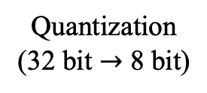
LDR Image formation pipeline
intensity
intensity
irradiance
LDR
intensity
Non-linear LDR
irradiance
Linear LDR
irradiance
HDR
Quantization
(32 bit $→$ 8 bit)
Non-linear mapping
Dynamic range clipping
Notes:
與前面介紹的方法一樣, 從LDR影像的生成pipeline出發

Slide 24
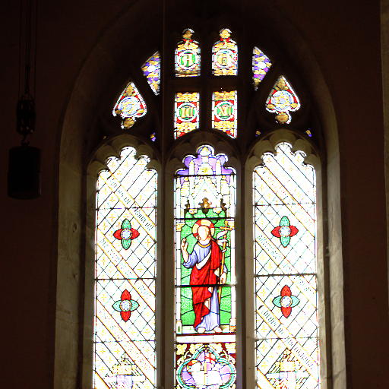
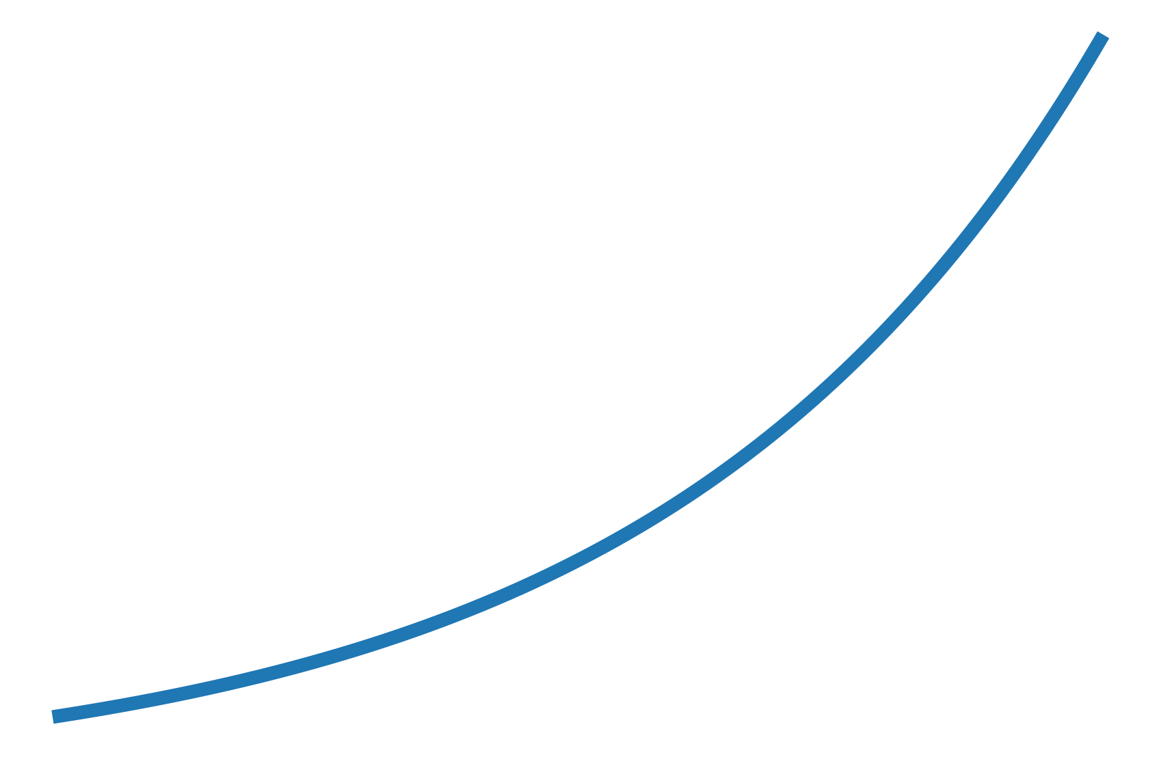
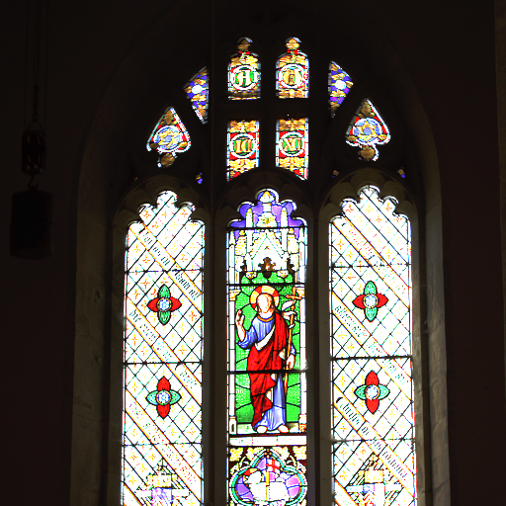
Approach
Learning to reverse each step of the LDR image formation pipeline
intensity
intensity
irradiance
LDR
intensity
Non-linear LDR
irradiance
Linear LDR
irradiance
HDR
Quantization
(32 bit $→$ 8 bit)
Non-linear mapping
Dynamic range clipping
Linearization-Net
Over-exposed
mask
Inverse CRF
Dequantization-Net
Hallucination-Net
Refinement-Net
LDR
32-bit LDR
Linear LDR
HDR
Our approach
Notes:
我們提出將LDR to HDR這個inverse problem分解為三個子任務，並學習專門的CNN來reverse這些步驟。
分別是Dequantization-Net, Linearization-Net, 以及Hallucination-Net

Slide 25
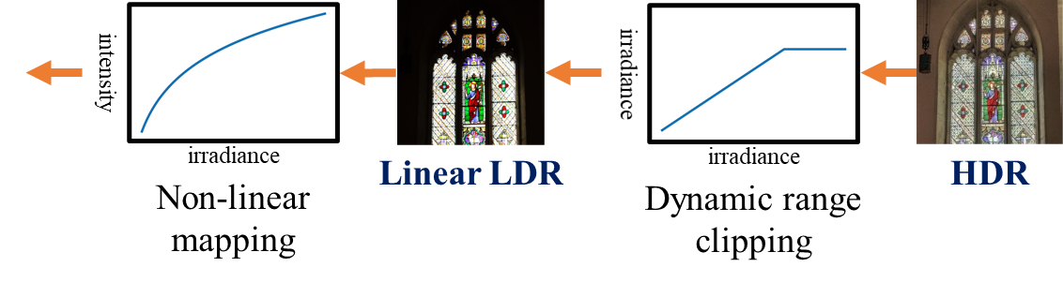
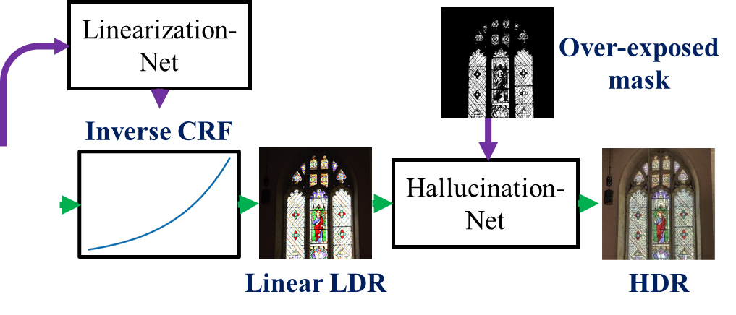
Approach
Learning to reverse each step of the LDR image formation pipeline
intensity
LDR
intensity
Non-linear LDR
Quantization
(32 bit $→$ 8 bit)
Dequantization-Net
LDR
32-bit LDR
Our approach
Notes:
我們的模型首先由Dequantization-Net還原由於quantization導致的細節缺失

Slide 26
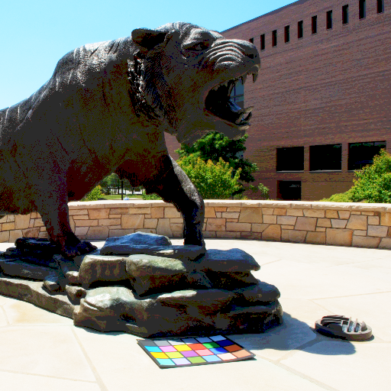
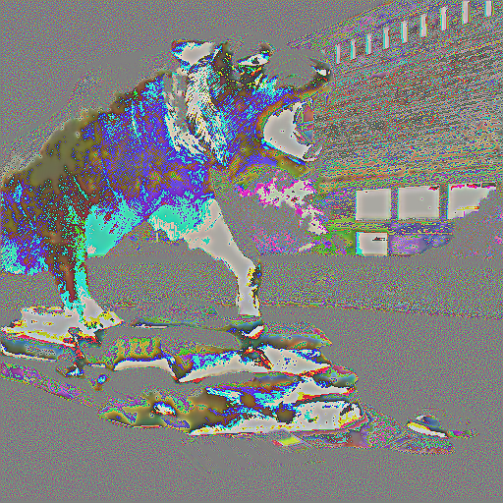

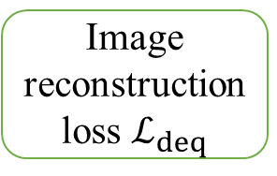

Dequantization-Net
Image reconstruction loss $ℒ_{deq}$
$$+$$
8-bit LDR
Dequantization-Net
Residual
32-bit LDR

Slide 27
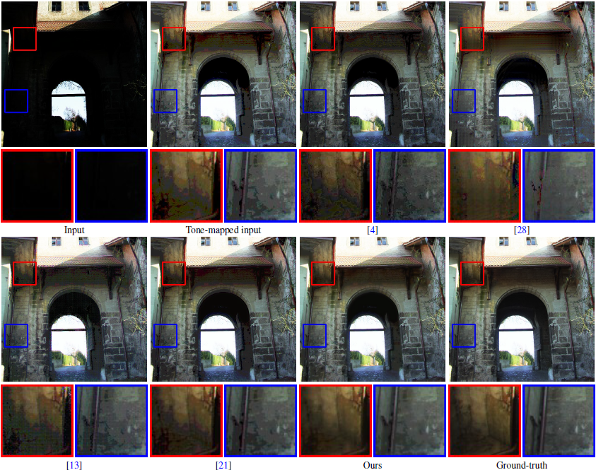
Dequantization-Net
Notes:
由這個例子可以看到dequantization-net的效用, input是一張拍得過暗的照片
若我們直接把這張影像用tone-mapping抬亮, 會產生許多不自然的塊狀斑點, 這就是quantization或是叫做banding artifacts
但經過Dequantization-Net產生32-bit image後, 這些artifacts便會消除許多
也會更接近ground truth

Slide 28
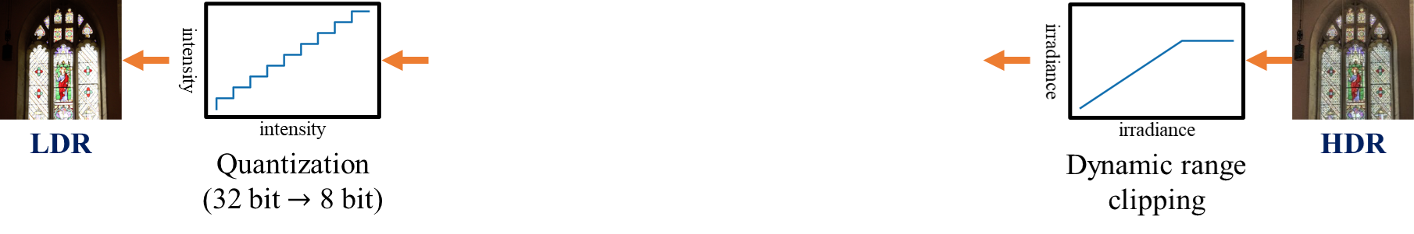
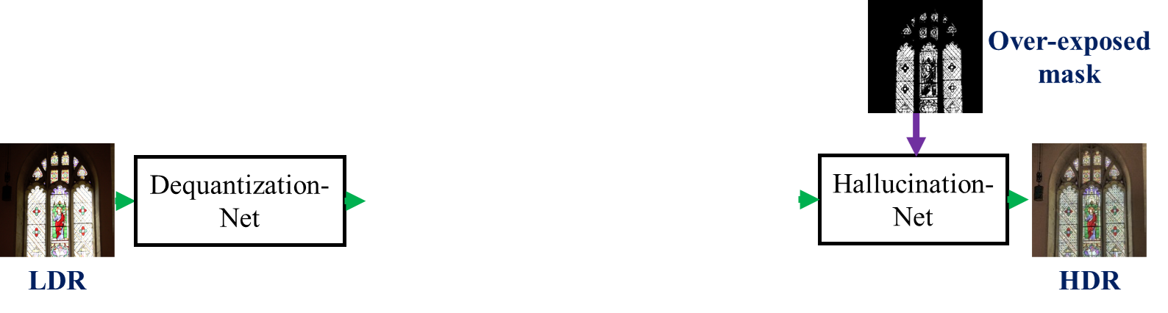
Approach
Learning to reverse each step of the LDR image formation pipeline
intensity
Non-linear LDR
irradiance
Linear LDR
Non-linear mapping
Linearization-Net
Inverse CRF
32-bit LDR
Linear LDR
Our approach
Notes:
經過上一步我們已經有了比較連續的32 bit LDR影像, 接著Linearization-Net會估計inverse-CRF並將non-linear LDR image轉換為linear image

Slide 29
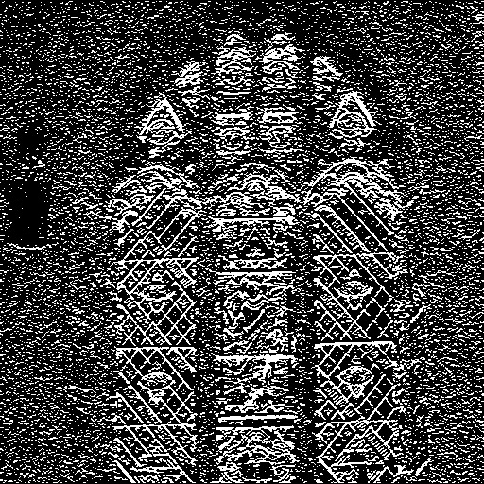
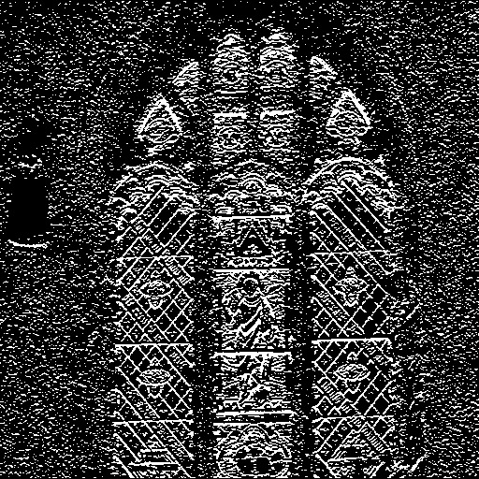
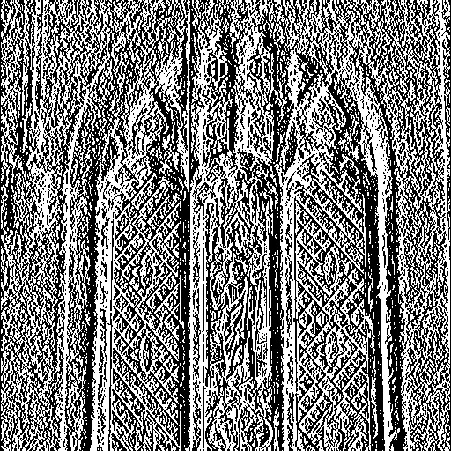

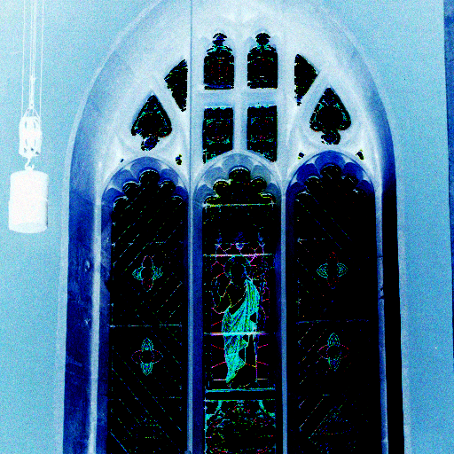
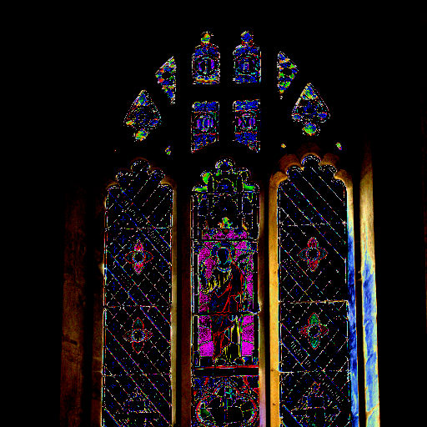








Linearization-Net
$$⋰$$
Sobel filter responses (6-D)
Global average pooling
Fully-connected layers
$$⋰$$
$$⋮$$
Non-linear LDR
K-D PCA weights
Soft histogram maps (84-D)
Monotonically increasing constraint
EMoR model
[Grossberg and Nayar 2004]
Linear LDR
Recovered inverse CRF $\tilde{g}$
Approximated inverse CRF $g$
Linear image reconstruction loss $ℒ_{lin}$
Inverse CRF loss $ℒ_{crf}$

Slide 30

Linearization-Net
ground truth
ground truth
Notes:
給定一張non-linear 32-bit的影像, Linearization-Net會根據這張影像裡的feature來估計出inverse-CRF
這張圖中黑色的線是ground-truth, 紅色的線是我們的方法估計出來的inverse-CRF, 其他的線則是比較的baselines, 可以看到我們估計出來的inverse-CRF更接近ground-truth, L2 error更小
接著可以看到經過我們的方法linearize之後的影像色調, 相比於state-of-the-art也更接近ground-truth

Slide 31


Approach
Learning to reverse each step of the LDR image formation pipeline
irradiance
Linear LDR
irradiance
HDR
Dynamic range clipping
Over-exposed
mask
Hallucination-Net
Linear LDR
HDR
Our approach
Notes:
經過第二步有了轉換回到linear domain的LDR影像, 第三個步驟是Hallucination-Net來預測過曝區域中的缺失內容

Slide 32









Hallucination-Net
Over-exposed mask
Perceptual loss $ℒ_{p}$
HDR Image reconstruction loss $ℒ_{hal}$
$$∘$$
$$+$$
ReLU
Linear LDR
Residual
Reconstructed HDR
TV loss $ℒ_{tv}$

Slide 33

Hallucination-Net
Input
Ours
Ground-truth
Notes:
這邊展示一些Hallucination-Net所還原的過曝區, 可以看到這些幾乎完全過曝的燈與窗戶, hallucination-Net都可以很好的還原出細節

Slide 34
Approach
Learning to reverse each step of the LDR image formation pipeline
intensity
intensity
irradiance
LDR
intensity
Non-linear LDR
irradiance
Linear LDR
irradiance
HDR
Quantization
(32 bit $→$ 8 bit)
Non-linear mapping
Dynamic range clipping
Linearization-Net
Over-exposed
mask
Inverse CRF
Dequantization-Net
Hallucination-Net
LDR
32-bit LDR
Linear LDR
HDR
Our approach
Notes:
到此為止我們講完了這三個network以及他們各自的任務, 那接下來說明一下怎麼做training

Slide 35
Approach
Learning to reverse each step of the LDR image formation pipeline
irradiance
Linear LDR
irradiance
HDR
Dynamic range clipping
Training pair for Hallucination-Net
Over-exposed
mask
Hallucination-Net
Linear LDR
HDR
Our approach
Notes:
從一張完美的HDR image出發, 我們逐步的對他做image formation pipeline中的破壞, 每一次的破壞我們都可以得到那個step的training pair, 例如對HDR做Dynamic range clipping就可以得到Hallucination-Net的training pair

Slide 36
Approach
Learning to reverse each step of the LDR image formation pipeline
intensity
Non-linear LDR
irradiance
Linear LDR
Non-linear mapping
Training pair for Linearization-Net
Linearization-Net
Inverse CRF
32-bit LDR
Linear LDR
Our approach
Notes:
接下來把Linear LDR轉到Non-linear domain就可以得到Linearization-Net的training pair

Slide 37
Approach
Learning to reverse each step of the LDR image formation pipeline
intensity
LDR
intensity
Non-linear LDR
Quantization
(32 bit $→$ 8 bit)
Training pair for Dequantization-Net
Dequantization-Net
LDR
32-bit LDR
Our approach
Notes:
最後是對Non-linear LDR做quantization就可以得到Dequantization-Net的training pair

Slide 38
Approach
Learning to reverse each step of the LDR image formation pipeline
intensity
intensity
irradiance
LDR
intensity
Non-linear LDR
irradiance
Linear LDR
irradiance
HDR
Quantization
(32 bit $→$ 8 bit)
Non-linear mapping
Dynamic range clipping
Linearization-Net
Over-exposed
mask
Inverse CRF
Dequantization-Net
Hallucination-Net
LDR
32-bit LDR
Linear LDR
HDR
Our approach
Notes:
所以到此為止, 我們已經很好的model了LDR image pipeline中的這三個步驟, 也step-by-step的train完這三個network了

Slide 39



Approach
Learning to reverse each step of the LDR image formation pipeline
intensity
intensity
irradiance
LDR
intensity
Non-linear LDR
irradiance
Linear LDR
irradiance
HDR
Quantization
(32 bit $→$ 8 bit)
Non-linear mapping
Dynamic range clipping
[Karaimer et al., ECCV’16]
Refinement-Net
HDR
Our approach
Notes:
但是, 現今的camera imaging pipeline已經不像是上面我們假設的這三個步驟這麼簡單了, 如同ECCV16年的這篇paper所model, 其中含有更多更複雜的非線性操作

Slide 40

Approach
Learning to reverse each step of the LDR image formation pipeline
intensity
intensity
irradiance
LDR
intensity
Non-linear LDR
irradiance
Linear LDR
irradiance
HDR
Quantization
(32 bit $→$ 8 bit)
Non-linear mapping
Dynamic range clipping
Refinement-Net
只要沒model到的，
Refinement-Net都能搞定
Model whatever cannot be modeled by the image formation pipeline above
HDR
Our approach
Notes:
因此最後我們使用Refinement-Net來model任何沒有被上面這個image formation pipeline model到的所有操作

Slide 41
Approach
Learning to reverse each step of the LDR image formation pipeline
intensity
intensity
irradiance
LDR
intensity
Non-linear LDR
irradiance
Linear LDR
irradiance
HDR
Quantization
(32 bit $→$ 8 bit)
Non-linear mapping
Dynamic range clipping
Linearization-Net
Over-exposed
mask
Inverse CRF
Dequantization-Net
Hallucination-Net
Refinement-Net
LDR
32-bit LDR
Linear LDR
HDR
Our approach
Notes:
並end-to-end的finetune整個model來減少錯誤累積

Slide 42
Approach
Learning to reverse each step of the LDR image formation pipeline
intensity
intensity
irradiance
LDR
intensity
Non-linear LDR
irradiance
Linear LDR
irradiance
HDR
Quantization
(32 bit $→$ 8 bit)
Non-linear mapping
Dynamic range clipping
Need LDR-HDR pairs from real cameras!
Linearization-Net
Over-exposed
mask
Inverse CRF
Dequantization-Net
Hallucination-Net
Refinement-Net
LDR
32-bit LDR
Linear LDR
HDR
Our approach
Notes:
但因為這時候的training我們是要考慮到現今真實的camera pipeline, 所以這時候的training pair就必須要是真實的LDR-HDR pair

Slide 43


















NTU VFX HDR Dataset
Notes:
因此與這篇paper一起, 我們實驗室也整理並公開了一個NTU VFX HDR dataset

Slide 44
NTU VFX HDR Dataset
Captured by ~600 amateurs
42 different cameras (NIKON D90, NEX-5N, Canon EOS 60D, etc.)
HDR fusion using Photomatix
480 HDR images
4,893 LDR images
Notes:
由大約600位學生於8年之間收集, 使用了42種不同的相機搭配腳架拍攝大量場景的多重曝光, 以商用軟體photomatix合成480 HDR以及成對的4,893 LDR影像

Slide 45
Approach
Learning to reverse each step of the LDR image formation pipeline
intensity
intensity
irradiance
LDR
intensity
Non-linear LDR
irradiance
Linear LDR
irradiance
HDR
Quantization
(32 bit $→$ 8 bit)
Non-linear mapping
Dynamic range clipping
Training pairs from NTU VFX HDR dataset
Linearization-Net
Over-exposed
mask
Inverse CRF
Dequantization-Net
Hallucination-Net
Refinement-Net
LDR
32-bit LDR
Linear LDR
HDR
Our approach
Notes:
我們就會使用上述的LDR-HDR pair來end-to-end的finetune整個model

Slide 46
Results
Notes:
接下來看一下結果

Slide 47

Quantitative comparison
Notes:
首先看一下量化的結果比較, 使用的evaluation metric是HDRVDP, 數字越高越好, 我們的方法都可以outperform其他state-of-the-art
若把整個testing set的HDRVDP畫成histogram, 可以看到我們的方法, 紅色的分布相比於其他顏色向右偏, 代表對於整個testing set裡面的image quality都有所提升

Slide 48

Qualitative comparison
Notes:
接著看一下我們的方法與其他state-of-the-art方法的比較, 可以看到HDRCNN因為沒有處理暗處, 所以容易產生quantization的artifacts, DrTMO受限於厚處裡的傳統演算法而會產生一些不自然的artifacts, 而ExpandNet只用單一CNN也無法很好的還原亮處與暗處的細節, 相對的我們的方法在暗處有較少的quantization error, 亮處細節也有產生而且整體色調也更加自然

Slide 49

Failure case
Notes:
由於single-image HDR reconstruction是一個ill-posed的問題, 所以這類的方法不可能完美的還原, 就像這個例子中, 窗外已經幾乎完全過曝, 剩下的資訊很少, 所以我們的方法也不可能重建出如ground-truth那樣完美的HDR影像

Slide 50
Approach
Learning to reverse each step of the LDR image formation pipeline
intensity
intensity
irradiance
LDR
intensity
Non-linear LDR
irradiance
Linear LDR
irradiance
HDR
Quantization
(32 bit $→$ 8 bit)
Non-linear mapping
Dynamic range clipping
Linearization-Net
Over-exposed
mask
Inverse CRF
Dequantization-Net
Hallucination-Net
Refinement-Net
LDR
32-bit LDR
Linear LDR
HDR
Our approach
Notes:
最後再summarize一下, 我們這邊paper提出了利用image formation pipeline的domain knowledge並學習專門的CNN去reverse這些步驟來達到從單張LDR影像還原HDR

Slide 51

Paper: http://bit.ly/im2HDR
Code: http://bit.ly/im2HDR_code
Notes:
最後，我們展示了我們方法的一些visual results 。更多結果可以參考我們的論文和網站, 謝謝!

Slide 52
Conclusions
A novel method for single-image HDR reconstruction leverages the domain knowledge of the LDR image formation pipeline to reverse the imaging process
Explicitly modeling the camera pipeline leads to improved generalization to unseen scenes
Extensive comparisons validate the effectiveness of our approach to restore visually pleasing details for a wide variety of challenging scenes

